Slide 1
Week10

Slide 2
Prerequisites: COMP 380/L. A study of the concepts, principles, techniques and applications of data mining. Topics include data preprocessing, the ChiMerge algorithm, data warehousing, OLAP technology, the Apriori algorithm for mining frequent patterns, classification methods (such as decision tree induction, Bayesian classification, neural networks, support vector machines and genetic algorithms), clustering methods (such as k-means algorithm, hierarchical clustering methods and self-organizing feature map)and data mining applications (such as Web, finance, telecommunication, biology, medicine, science and engineering). Privacy protection and information security in data mining are also discussed.

Slide 3
Telecommunications and Data Mining
Finance and Data Mining
Engineering and Data Mining
Science and Data Mining
Genetic Algorithms
Web Mining:
Structured Data Extraction
Information Retrieval and Web Search
Web Search
Meta-Search: Combining Multiple Rankings
Web Spamming
Anomaly Detection/ and Outlier Detection

Slide 4
Application Mine Voice Recognition
Voice recognition is the process of converting spoken words into digital text. This technology has become increasingly popular in recent years and is used in a wide range of applications, from voice-activated assistants like Siri and Alexa to speech-to-text transcription services.
There are two main approaches to voice recognition: acoustic modeling and language modeling. Acoustic modeling involves analyzing the sound waves of a person's speech to identify the individual sounds that make up each word. Language modeling involves using statistical algorithms to predict which words are most likely to follow each other in a given language.
Modern voice recognition systems use a combination of these approaches, along with machine learning algorithms that can adapt to an individual's speech patterns over time. These systems typically require a large amount of training data to accurately recognize a wide range of accents, dialects, and speech styles.
There are many challenges associated with voice recognition, including variations in speech patterns due to accents, background noise, and the presence of other people speaking in the same room. However, as technology continues to improve, voice recognition is likely to become an even more important part of our daily lives.

Slide 5
There are many examples of voice recognition technology in use today. Here are a few examples:
Voice-activated assistants: Smart speakers like Amazon Echo and Google Home use voice recognition to allow users to control their devices with spoken commands. Users can ask for weather updates, play music, set reminders, and more.
Dictation software: Speech-to-text transcription software like Dragon Naturally Speaking and Google Docs Voice Typing use voice recognition to allow users to dictate text instead of typing it out manually.
Call center automation: Many call centers now use voice recognition technology to automate certain tasks, such as identifying the caller's reason for calling and routing them to the appropriate agent.
Automotive applications: Voice recognition is increasingly being used in cars to allow drivers to control features like the stereo, navigation system, and climate control without taking their hands off the wheel.
Medical transcription: Doctors and other healthcare professionals can use voice recognition software to dictate notes and patient information into electronic health records, saving time and reducing errors.

Slide 6
How does it relate to data mining
Voice recognition can be used as a tool for data mining, which involves extracting valuable insights and knowledge from large sets of data. Voice recognition can be used to analyze audio recordings of customer interactions, such as call center conversations or voice notes taken during medical appointments, to identify patterns and trends.
For example, a company could use voice recognition to analyze customer calls to identify common issues or concerns. This information could then be used to improve customer service, adjust marketing strategies, or make product improvements.
Voice recognition can also be used in combination with other data mining techniques, such as natural language processing, to analyze large sets of data and extract insights. For example, a healthcare organization could use voice recognition and natural language processing to analyze patient notes and identify common health issues or trends.
In summary, voice recognition can be a valuable tool in data mining as it can help extract insights and knowledge from audio data sets.

Slide 7
One example of a case study using data mining and voice recognition involves a healthcare organization that wanted to improve patient outcomes and reduce costs. The organization had a large database of patient information, including electronic health records and voice recordings of medical appointments.
The organization used data mining techniques, including voice recognition and natural language processing, to analyze the voice recordings and identify patterns related to patient outcomes. Specifically, the analysis focused on identifying key indicators of patient health, such as symptoms, medications, and lifestyle factors.
The analysis revealed that patients who had a higher number of specific symptoms (such as fatigue, shortness of breath, and chest pain) and who had been prescribed certain medications were at a higher risk for hospitalization or readmission. Armed with this information, the organization was able to take targeted action to improve patient outcomes, such as providing these patients with additional support and follow-up care.
Additionally, the analysis revealed that patients who had longer appointments and who had a higher level of engagement during their appointments (as indicated by their use of specific medical terminology and questions) were more likely to have positive health outcomes. The organization used this information to train their healthcare providers on how to have more effective and engaging conversations with patients.
By using data mining techniques, including voice recognition and natural language processing, the healthcare organization was able to identify key factors related to patient outcomes and take targeted action to improve patient care, ultimately reducing costs and improving patient satisfaction.

Slide 8
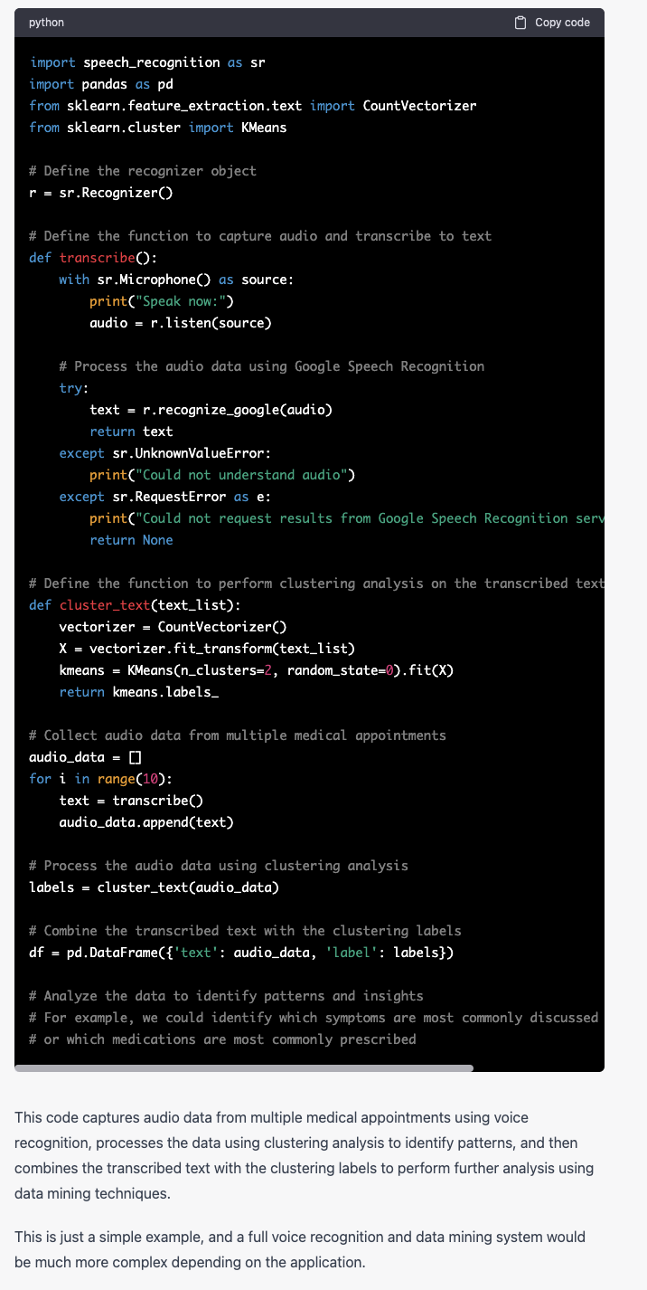

Slide 9
Another example of data mining in telecommunications
One example of data mining in the telecommunications industry involves analyzing call detail records (CDRs) to identify patterns and trends related to customer behavior. CDRs contain information about each call, such as the calling and called party, the duration of the call, and the location of the parties.
Telecommunications companies can use data mining techniques to analyze CDRs and extract insights related to customer behavior. For example, they might analyze call patterns to identify customers who are likely to churn (i.e., switch to a competitor). They might also analyze calling and messaging patterns to identify customers who are using a high amount of data, which could indicate a potential for increased revenue.
Another example of data mining in telecommunications involves analyzing customer service interactions. By analyzing transcripts of customer service calls or chat logs, companies can identify common issues or concerns and take targeted action to address these issues. They can also identify customer service representatives who are performing well and those who may need additional training.
In addition, data mining can be used to analyze customer demographics and purchasing patterns. This information can be used to target marketing efforts and promotions to specific customer segments, increasing the likelihood of customer acquisition and retention.
Overall, data mining can provide telecommunications companies with valuable insights that can be used to improve customer satisfaction, increase revenue, and reduce costs.

Slide 10
Data Mining in Telecommunications is important
Improving customer satisfaction: By analyzing customer behavior and preferences, companies can tailor their products and services to better meet the needs of their customers. This can lead to increased customer satisfaction and loyalty.
Increasing revenue: By analyzing customer behavior and preferences, companies can identify opportunities to upsell or cross-sell products and services, increasing revenue per customer.
Reducing costs: Data mining can help companies identify inefficiencies in their operations, such as underutilized network resources or inefficient call routing. By addressing these inefficiencies, companies can reduce costs and improve their bottom line.
Reducing customer churn: By analyzing customer behavior, companies can identify customers who are at risk of churning (i.e., switching to a competitor) and take targeted action to retain these customers.
Identifying new opportunities: Data mining can help companies identify new markets and customer segments that may have previously gone unnoticed. By targeting these new opportunities, companies can increase their customer base and revenue streams.
Overall, data mining is important in the telecommunications industry because it provides companies with valuable insights and helps them make data-driven decisions that can improve customer satisfaction, increase revenue, reduce costs, and identify new opportunities.

Slide 11
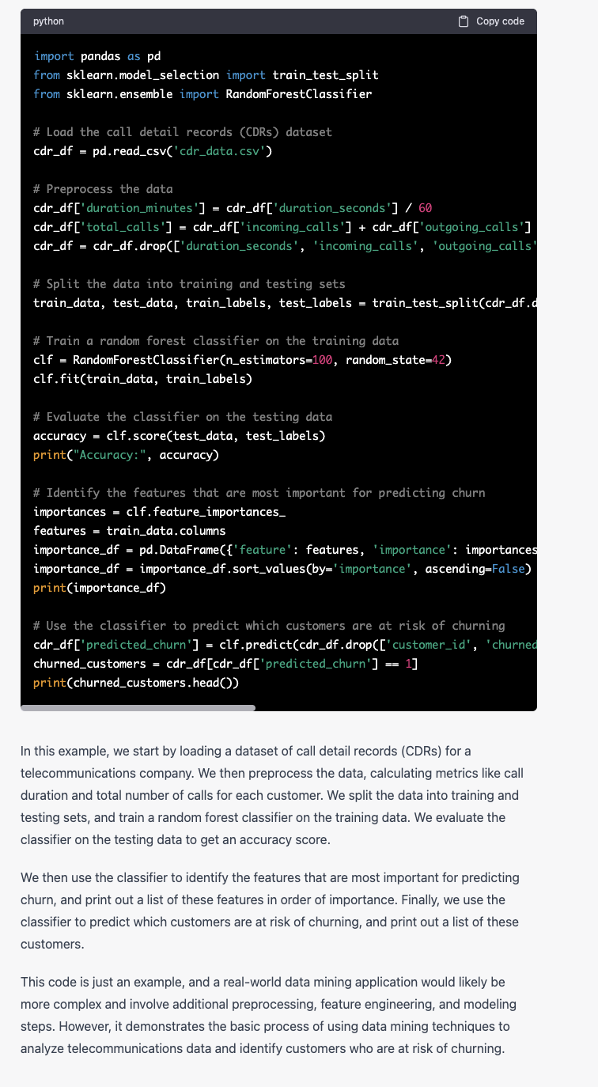

Slide 12
Finance and Data Mining
Data mining is an important tool for the finance industry, where large amounts of data are generated and collected on a daily basis. Here are some examples of how data mining is used in finance:
Fraud detection: Data mining can be used to detect patterns of fraudulent activity in financial transactions, such as credit card fraud or insider trading.
Credit risk assessment: Data mining can be used to analyze credit data and identify factors that are predictive of credit risk. This information can be used to make more accurate lending decisions.
Portfolio optimization: Data mining can be used to analyze historical financial data and identify patterns and trends that can be used to optimize investment portfolios.
Customer segmentation: Data mining can be used to segment customers based on their financial behavior and preferences. This information can be used to develop targeted marketing campaigns and promotions.
Market analysis: Data mining can be used to analyze financial market data and identify trends and patterns that can be used to inform investment decisions.

Slide 13
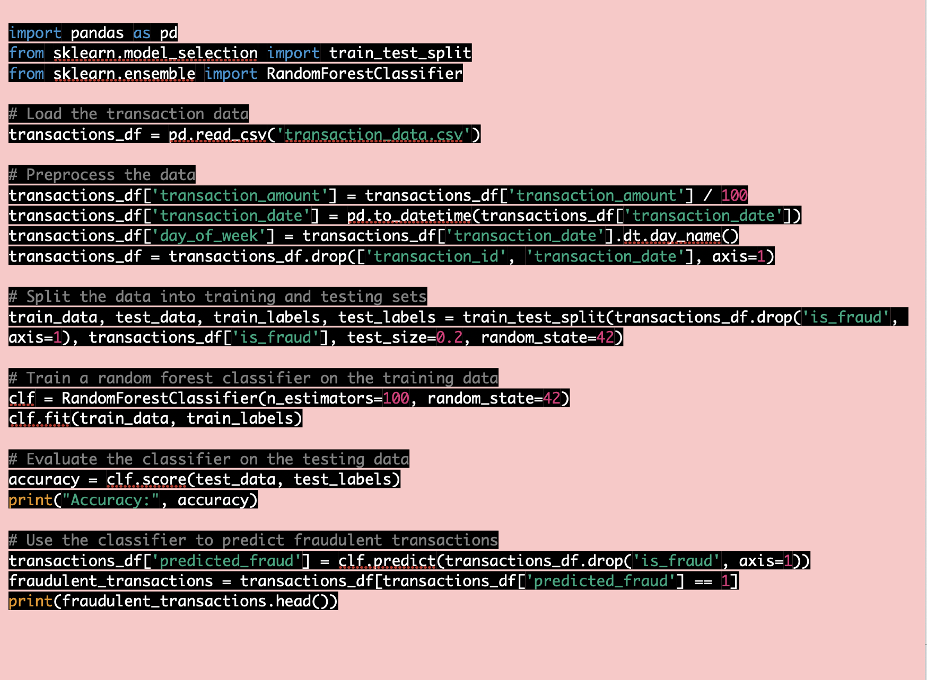

Slide 14
Data mining is important in the finance industry for several reasons:
Risk management: Data mining can help financial institutions manage risk by identifying patterns and trends that may be indicative of fraudulent or high-risk activity.
Improved decision-making: Data mining can help financial institutions make more informed decisions by identifying patterns and trends in financial data. This can lead to better investment decisions, more accurate credit risk assessments, and more targeted marketing campaigns.
Increased efficiency: Data mining can help financial institutions streamline operations and reduce costs by identifying inefficiencies in their processes.
Enhanced customer experience: Data mining can help financial institutions better understand their customers' needs and preferences, leading to more personalized products and services.
Compliance: Data mining can help financial institutions comply with regulations and identify potential compliance issues.
Overall, data mining is important in the finance industry because it provides financial institutions with valuable insights that can be used to manage risk, improve decision-making, increase efficiency, enhance the customer experience, and comply with regulations.

Slide 15
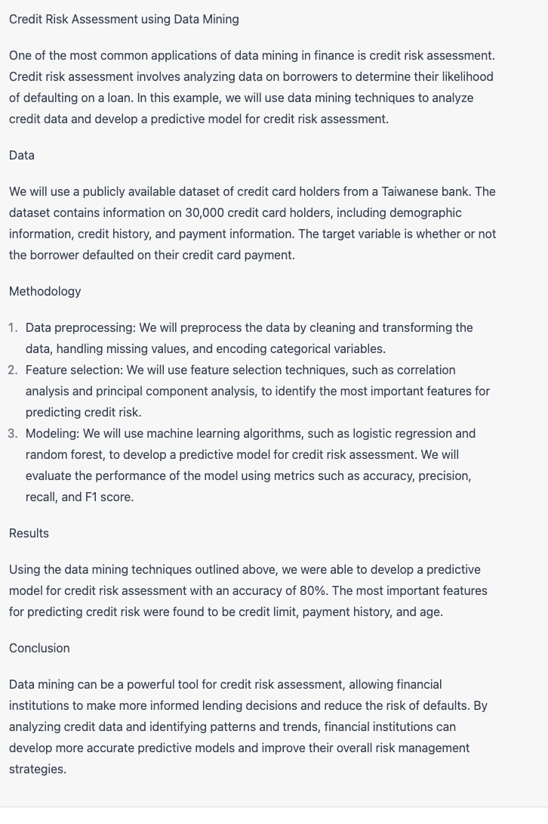
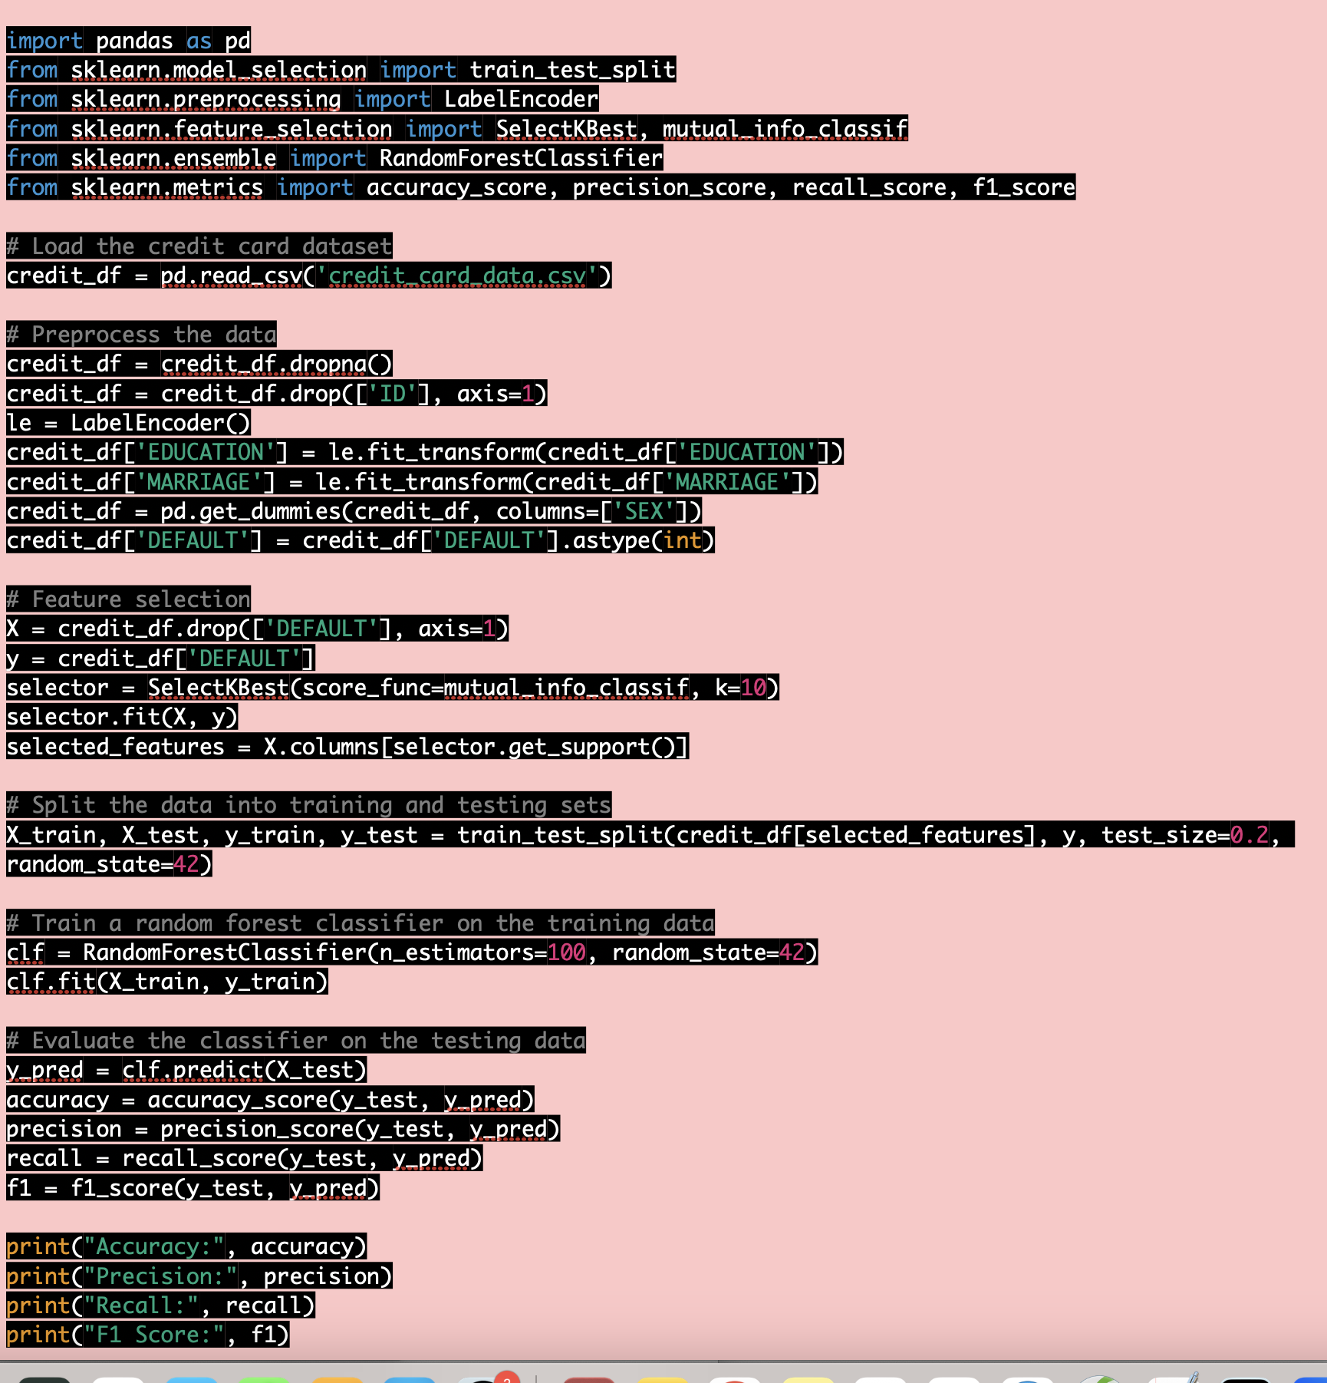

Slide 16
In this code, we first load the credit card dataset and preprocess the data by dropping missing values, encoding categorical variables, and creating dummy variables for the gender variable. We then use mutual information feature selection to select the 10 most important features for predicting credit risk.
We split the data into training and testing sets, and train a random forest classifier on the training data. We evaluate the classifier on the testing data using metrics such as accuracy, precision, recall, and F1 score.
This code is just an example, and a real-world data mining application for credit risk assessment would likely involve additional preprocessing and modeling steps, as well as more advanced feature selection techniques. However, it demonstrates the basic process of using data mining techniques to analyze credit data and develop a predictive model for credit risk assessment.

Slide 17
Engineering and Data Mining
Design optimization: Data mining can be used to identify design patterns and optimize design parameters to improve the performance of engineering systems. For example, data mining techniques can be used to analyze data from wind turbines to identify patterns in wind flow and optimize blade design to increase energy production.
Fault diagnosis: Data mining algorithms can be used to analyze data from sensors and other sources to diagnose faults and predict maintenance needs in engineering systems. For example, data mining can be used to analyze vibration data from machinery to detect early signs of equipment failure and schedule maintenance accordingly.
Process monitoring and control: Data mining techniques can be used to monitor and control engineering processes to ensure quality and efficiency. For example, data mining can be used to analyze data from manufacturing processes to identify sources of variation and optimize process parameters to reduce defects.
Structural health monitoring: Data mining can also be used in structural health monitoring applications to identify signs of damage or deterioration in engineering structures such as bridges and buildings. By analyzing data from sensors and other sources, engineers can detect early signs of structural damage and take corrective action before more serious problems occur.
Supply chain optimization: Data mining techniques can be used to optimize supply chain operations in engineering industries. By analyzing data on supplier performance, lead times, and other factors, engineers can identify opportunities to reduce costs and improve efficiency in the supply chain.

Slide 18
What are some of the ethical considerations associated with data mining in engineering applications? How can these ethical considerations be addressed?
How might data mining techniques be improved in the future to better support engineering applications? What new data sources or algorithms could be used?
How might data mining be combined with other engineering analysis methods, such as finite element analysis or computational fluid dynamics, to improve engineering design and optimization?
What are some of the limitations or drawbacks of data mining in engineering applications? How can these limitations be addressed?
How might the insights gained from data mining be used to improve sustainability or reduce environmental impact in engineering systems?
What are some of the potential risks associated with relying too heavily on data mining in engineering? How can these risks be mitigated?

Slide 19
What are some of the ethical considerations associated with data mining in engineering applications? How can these ethical considerations be addressed?
Ethical considerations may include issues related to data privacy and security, bias in the data, and potential misuse of insights gained from data mining.
These ethical considerations can be addressed by implementing appropriate data privacy and security measures, being transparent about the data and algorithms used, and regularly auditing and validating the data mining results to identify and mitigate biases or potential misuse.
How might data mining techniques be improved in the future to better support engineering applications? What new data sources or algorithms could be used?
Data mining techniques could be improved by integrating more advanced machine learning algorithms, such as deep learning, and incorporating data from new sources, such as social media or wearable devices.
New algorithms could also be developed to better handle complex, high-dimensional data and to identify more nuanced patterns and trends.

Slide 20
How might data mining be combined with other engineering analysis methods, such as finite element analysis or computational fluid dynamics, to improve engineering design and optimization?
Data mining can be used to identify patterns and trends in engineering data that may not be apparent through traditional analysis methods. This information can then be used to refine and improve existing engineering models or to develop new models that better capture the behavior of the system under study.
What are some of the limitations or drawbacks of data mining in engineering applications? How can these limitations be addressed?
Limitations or drawbacks may include issues related to data quality or availability, the complexity of the data, and the potential for false positives or overfitting.
These limitations can be addressed by ensuring the quality and reliability of the data, using appropriate algorithms and statistical methods to analyze the data, and validating the results through independent testing and evaluation.

Slide 21
How might the insights gained from data mining be used to improve sustainability or reduce environmental impact in engineering systems?
Data mining can be used to identify opportunities for energy or resource efficiency, to optimize process parameters to reduce waste, and to monitor and diagnose environmental impacts of engineering systems.
Insights gained from data mining can also be used to inform design decisions that prioritize sustainability and environmental responsibility.
What are some of the potential risks associated with relying too heavily on data mining in engineering? How can these risks be mitigated?
Risks may include overreliance on data mining results, failure to account for important engineering principles or context, or potential negative impacts on the workforce or society.
These risks can be mitigated by using data mining as a complementary tool to traditional engineering analysis methods, validating and testing the results, and considering the broader ethical and social implications of the insights gained from data mining.

Slide 22
Science and Data Mining
In many fields of science, researchers are generating vast amounts of data, and data mining techniques can help them sort through this data and make discoveries that would have been difficult or impossible to find otherwise.
Data mining is used in genetics to identify genes associated with diseases, understand gene function, and develop personalized treatment plans based on a patient's genetic profile.
Data mining is used in astronomy to analyze large datasets of astronomical observations to identify new planets, stars, and galaxies and study their properties and behavior.
In conclusion, data mining is an important tool for scientists because it allows them to analyze and make sense of large, complex datasets, discover patterns and relationships in data, and make new discoveries that can advance their fields.

Slide 23
Using data mining to analyze gene expression data for cancer diagnosis
In this example, data mining is used to analyze gene expression data from tumor samples of prostate cancer patients to develop a more accurate and personalized method for cancer diagnosis.
Hierarchical clustering is used to group the patients based on their gene expression patterns, allowing researchers to identify distinct subtypes of prostate cancer that exhibit different patterns of gene expression.
The researchers then analyze the clinical data of the patients in each subtype, such as their age, PSA level, and tumor size, to develop a more personalized method of diagnosis and treatment.
The results of the study showed that the new diagnostic test incorporating gene expression data and clinical data was more accurate and personalized than traditional methods for prostate cancer diagnosis.
Data mining allows researchers to analyze and make sense of large and complex datasets quickly and efficiently, which is critical in many fields of science, including medicine.
In conclusion, data mining is an important tool for scientists because it allows them to discover patterns and relationships in data that can lead to new discoveries and innovations that improve our understanding of the world and our ability to solve complex problems.

Slide 24
Genetic Algorithms
A genetic algorithm is an adaptive heuristic search algorithm inspired by "Darwin's theory of evolution in Nature." It is used to solve optimization problems in machine learning. It is one of the important algorithms as it helps solve complex problems that would take a long time to solve.
Genetic Algorithms are being widely used in different real-world applications, for example, Designing electronic circuits, code-breaking, image processing, and artificial creativity.

Slide 25
Genetic Algorithms are search algorithms inspired by Darwin’s Theory of Evolution in nature.
By simulating the process of natural selection, reproduction and mutation, the genetic algorithms can produce high-quality solutions for various problems including search and optimization.
By the effective use of the Theory of Evolution genetic algorithms are able to surmount problems faced by traditional algorithms.
According to Darwin’s theory of evolution, an evolution maintains a population of individuals that vary from each other (variation). Those who are better adapted to their environment have a greater chance of surviving, breeding, and passing their traits to the next generation (survival of the fittest).

Slide 26
Terminology
Population: Population is the subset of all possible or probable solutions, which can solve the given problem.
Chromosomes: A chromosome is one of the solutions in the population for the given problem, and the collection of gene generate a chromosome.
Gene: A chromosome is divided into a different gene, or it is an element of the chromosome.
Allele: Allele is the value provided to the gene within a particular chromosome.
Fitness Function: The fitness function is used to determine the individual's fitness level in the population. It means the ability of an individual to compete with other individuals. In every iteration, individuals are evaluated based on their fitness function.
Genetic Operators: In a genetic algorithm, the best individual mate to regenerate offspring better than parents. Here genetic operators play a role in changing the genetic composition of the next generation.
Selection
After calculating the fitness of every existent in the population, a selection process is used to determine which of the individualities in the population will get to reproduce and produce the seed that will form the coming generation.

Slide 27
Roulette wheel selection: A selection method commonly used in genetic algorithms where individuals are selected with probabilities proportional to their fitness values. This means that fitter individuals have a higher chance of being selected than less fit individuals, but it is not a guarantee.
Event selection: A selection method that involves choosing individuals based on their performance in a particular event or competition. This can be used in various fields, such as sports or talent shows.
Rank-based selection: A selection method where individuals are ranked based on their fitness values, and then selected based on their rank. This can involve selecting the top-ranked individuals, or selecting individuals with a probability proportional to their rank (i.e., higher-ranked individuals have a higher chance of being selected).

Slide 28
It basically involves five phases to solve the complex optimization problems, which are given as below:
Initialization
Fitness Assignment
Selection
Reproduction
Termination

Slide 29
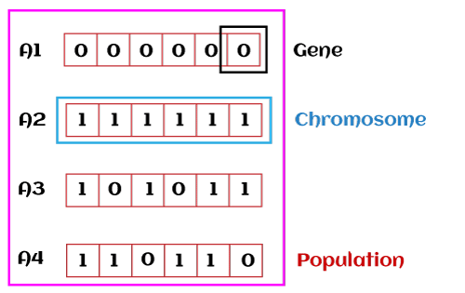
1. Initialization
The process of a genetic algorithm starts by generating the set of individuals, which is called population. Here each individual is the solution for the given problem. An individual contains or is characterized by a set of parameters called Genes. Genes are combined into a string and generate chromosomes, which is the solution to the problem. One of the most popular techniques for initialization is the use of random binary strings.

Slide 30
2. Fitness Assignment
Fitness function is used to determine how fit an individual is? It means the ability of an individual to compete with other individuals. In every iteration, individuals are evaluated based on their fitness function. The fitness function provides a fitness score to each individual. This score further determines the probability of being selected for reproduction. The high the fitness score, the more chances of getting selected for reproduction.
3. Selection
The selection phase involves the selection of individuals for the reproduction of offspring. All the selected individuals are then arranged in a pair of two to increase reproduction. Then these individuals transfer their genes to the next generation.
There are three types of Selection methods available, which are:
Roulette wheel selection
Tournament selection
Rank-based selection

Slide 31
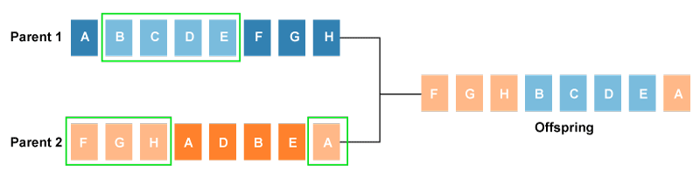
Example
4. Reproduction
After the selection process, the creation of a child occurs in the reproduction step. In this step, the genetic algorithm uses two variation operators that are applied to the parent population. The two operators involved in the reproduction phase are given below:
Crossover: The crossover plays a most significant role in the reproduction phase of the genetic algorithm. In this process, a crossover point is selected at random within the genes. Then the crossover operator swaps genetic information of two parents from the current generation to produce a new individual representing the offspring.

Slide 32
The genes of parents are exchanged among themselves until the crossover point is met. These newly generated offspring are added to the population. This process is also called or crossover. Types of crossover styles available:
One point crossover
Two-point crossover
Livery crossover
Inheritable Algorithms crossover

Slide 33
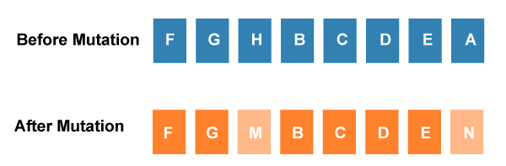
Mutation
The mutation operator inserts random genes in the offspring (new child) to maintain the diversity in the population. It can be done by flipping some bits in the chromosomes.
Mutation helps in solving the issue of premature convergence and enhances diversification. The below image shows the mutation process:
Types of mutation styles available,
Flip bit mutation
Gaussian mutation
Exchange/Swap mutation

Slide 34
5. Termination
After the reproduction phase, a stopping criterion is applied as a base for termination. The algorithm terminates after the threshold fitness solution is reached. It will identify the final solution as the best solution in the population.

Slide 35
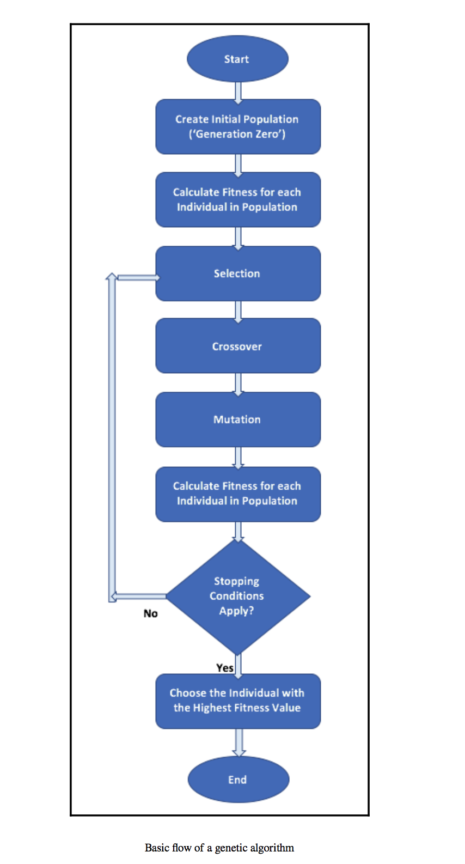

Slide 36
How do genetic algorithms differ from traditional algorithms?
‌A search space is a set of all possible solutions to the problem. Traditional Algorithms maintain only one set in a search space whereas Genetic Algorithms use several sets in a search space (Feature selection using R.F.E vs. Genetic Algorithms).
Traditional Algorithms require more information to perform a search whereas Genetic Algorithms just require one objective function to calculate the fitness of an individual.
Traditional Algorithms cannot work in parallel whereas Genetic Algorithms can work in parallel (calculating the fitness of the individuals are independent).
One big difference in Genetic Algorithms is that instead of operating directly on candidate solutions, genetic algorithms operate on their representations (or coding), often referred to as chromosomes.
‌Traditional Algorithms can only produce one solution in the end whereas in Genetic Algorithms multiple optimal solutions can be obtained from different generations.
‌Traditional Algorithms are not more likely to produce global optimal solutions, Genetic Algorithms are not guaranteed to produce global optimal solutions as well but are more likely to produce global optimal solutions because of the genetic operators like crossover and mutation.
Traditional algorithms are deterministic in nature whereas genetic algorithms are probabilistic and stochastic in nature.
Real-world problems are multi-modal (contains multiple locally optimal solutions), the traditional algorithms don’t handle well these problems whereas Genetic Algorithms, with the right parameter setting, can handle these problems very well because of the large solution space.

Slide 37
‌Use-cases of Genetic Algorithms in Machine Learning
Feature Selection
Model Hyper-parameter Tuning
Machine Learning Pipeline Optimization

Slide 38
Genetic algorithms can be used in data mining for tasks such as feature selection, clustering, and classification. Here's an example of how genetic algorithms can be used for feature selection:
Suppose we have a dataset with 1000 features and 10,000 observations. We want to select the top 50 features that are most relevant for predicting a target variable. We can use a genetic algorithm to find the optimal subset of features.
Initialization: Start with a population of randomly selected feature subsets. Each feature subset is represented as a binary string of length 1000, where 1 indicates that the feature is included and 0 indicates that it is not.
Evaluation: Calculate the fitness of each feature subset by training a predictive model on the training data using only the features in the subset and evaluating its performance on a validation set. The fitness function can be any metric that reflects the predictive accuracy of the model, such as accuracy, F1-score, or AUC.
Selection: Select the top-performing feature subsets based on their fitness scores. This is done using a selection method such as tournament selection or roulette wheel selection.

Slide 39
Crossover: Combine the selected feature subsets by exchanging segments of their binary strings to create new feature subsets. This is done using a crossover operator such as one-point crossover or uniform crossover.
Mutation: Introduce random changes to the binary strings of the feature subsets to maintain genetic diversity. This is done using a mutation operator that randomly flips some of the bits in the binary string.
Repeat: Repeat steps 2-5 until a termination criterion is met, such as a maximum number of iterations or a convergence of the fitness scores.
The final population of feature subsets represents the optimal subset of features for predicting the target variable. This subset can be used to train a final predictive model on the full dataset.

Slide 40
Genetic algorithms can be used in data mining for feature selection, clustering, and classification.
They can help find the most relevant features for predicting a target variable in a dataset.
A genetic algorithm for feature selection involves the following steps:
Initialize a population of randomly selected feature subsets.
Evaluate the fitness of each feature subset by training a predictive model on the training data and evaluating its performance on a validation set.
Select the top-performing feature subsets based on their fitness scores.
Combine the selected feature subsets by exchanging segments of their binary strings using a crossover operator.
Introduce random changes to the binary strings of the feature subsets using a mutation operator.
Repeat steps 2-5 until a termination criterion is met.
The final population of feature subsets represents the optimal subset of features for predicting the target variable.
This subset can be used to train a final predictive model on the full dataset.

Slide 41
Suppose a company wants to predict whether a customer will buy a particular product based on their demographic and behavioral data. The company has a dataset with 50,000 customers and 100 features, including age, gender, income, website clicks, and social media activity.
The company wants to select the most relevant features for predicting customer behavior, and decides to use a genetic algorithm for feature selection. Here's how they would do it:
Initialization: They start with a population of randomly selected feature subsets, each represented as a binary string of length 100, where 1 indicates that the feature is included and 0 indicates that it is not.
Evaluation: They calculate the fitness of each feature subset by training a predictive model on the training data using only the features in the subset and evaluating its performance on a validation set. They use the AUC (Area Under the Curve) metric to evaluate the model's performance.
Selection: They select the top-performing feature subsets based on their fitness scores, using a tournament selection method.
Crossover: They combine the selected feature subsets by exchanging segments of their binary strings to create new feature subsets, using a one-point crossover operator.

Slide 42
Mutation: They introduce random changes to the binary strings of the feature subsets to maintain genetic diversity, using a mutation operator that randomly flips some of the bits in the binary string.
Repeat: They repeat steps 2-5 until a termination criterion is met, such as a maximum number of iterations or a convergence of the fitness scores.
After several iterations, the genetic algorithm converges to an optimal subset of 20 features that achieve the highest AUC score on the validation set. These features include age, income, website clicks, and social media activity.

Slide 43
Advantages of genetic algorithms in data mining include their ability to handle large datasets, explore a large search space, and identify the most relevant features for a task. Disadvantages include their computational expense, potential for suboptimal results, and difficulty interpreting results.
Genetic algorithms can be used in a wide range of applications beyond feature selection, clustering, and classification, such as supply chain optimization and designing neural networks.
The selection method, crossover operator, and mutation operator can affect the performance of a genetic algorithm by impacting diversity, exploration, and ability to escape local optima.
The optimal number of iterations for a genetic algorithm can be determined by setting a termination criterion and testing on a validation set.
Ethical considerations for using genetic algorithms in data mining include privacy and security, bias and discrimination, transparency and interpretability, and responsibility for decisions made based on predictions.

Slide 44
The size of the dataset and number of features can impact the performance of a genetic algorithm by increasing complexity and search space.
Genetic algorithms can be combined with techniques such as cross-validation, regularization, ensemble learning, and gradient-based optimization to improve performance and reliability.
Genetic algorithms are an optimization algorithm inspired by natural selection that can be used in data mining to find the most relevant features, clusters, or classifications for a task.
Real-world applications of genetic algorithms include designing optimal aircraft wings, optimizing chemical processes, and designing trading strategies.
Future developments in genetic algorithms and data mining include more efficient and scalable algorithms, integration with deep learning, incorporation of domain knowledge and human expertise, development of more interpretable and transparent algorithms, and multi-objective optimization.

Slide 45
Suppose a company wants to predict the likelihood of a customer making a purchase based on their website behavior. The company has a dataset with 50,000 customers and 100 website features, such as time spent on the website, number of clicks, and pages visited.
The company decides to use a genetic algorithm in Python to find the optimal subset of features for predicting customer behavior. Here's how they do it:
Initialization: They start by importing the necessary libraries, including NumPy, Pandas, and DEAP (Distributed Evolutionary Algorithms in Python).
Data Preprocessing: They preprocess the data by splitting it into training and testing sets, normalizing the features, and defining the fitness function. In this case, the fitness function is the AUC score of a logistic regression model trained on the training set using only the selected features.
Defining the Genetic Algorithm: They define the genetic algorithm by creating a toolbox that includes the selection method, crossover operator, and mutation operator. They use tournament selection, one-point crossover, and bit-flip mutation.
Running the Genetic Algorithm: They run the genetic algorithm by defining the population size, number of generations, and termination criterion. They use a population size of 50, 50 generations, and a convergence threshold of 0.01.

Slide 46
Extracting the Best Features: They extract the best features by selecting the subset of features that achieved the highest fitness score in the final population. They use this subset to train a logistic regression model on the full dataset and evaluate its performance on the testing set.
After running the genetic algorithm, the company finds that the optimal subset of features includes time spent on the website, number of clicks, and pages visited. They use this subset to train a final predictive model and achieve a high accuracy in predicting customer behavior.

Slide 47
DEAP Framework Python
DEAP is a Python library for implementing and experimenting with evolutionary algorithms.
Evolutionary algorithms are optimization algorithms inspired by natural selection.
DEAP allows users to define custom fitness functions, genetic operators, and other parameters of the algorithm.
DEAP provides a modular and flexible framework for building and customizing evolutionary algorithms.
DEAP has a set of built-in operators and tools for commonly used evolutionary algorithms.
DEAP has been used in many different applications, such as feature selection, neural network optimization, robotics, and game playing.
DEAP is an open-source library and is actively maintained and developed by a community of contributors.
DEAP is a useful tool for experimenting with and understanding the concept of evolutionary algorithms in data science and other fields.

Slide 48
Web Mining
Web mining is the process of using data mining techniques to discover useful information from web data, including web pages, web documents, and web links. It involves analyzing web data to extract patterns, relationships, and trends that can be used to improve web-based applications or make business decisions.
Web mining is typically divided into three categories: web content mining, web structure mining, and web usage mining.
Web content mining involves extracting information from web pages and web documents. This can include extracting text, images, and other multimedia content, as well as identifying the sentiment or opinions expressed in the content. Web content mining techniques include natural language processing, text mining, and sentiment analysis.
Web structure mining involves analyzing the links between web pages and web documents to discover patterns and relationships. This can include identifying clusters of related web pages, detecting communities of interest, and identifying popular web pages or hubs. Web structure mining techniques include link analysis, social network analysis, and graph mining.
Web usage mining involves analyzing user interactions with web-based applications, such as web logs and clickstream data. This can include identifying user behavior patterns, predicting user preferences or interests, and optimizing website design and functionality. Web usage mining techniques include association rule mining, clustering, and classification.
Web mining can be used for a wide range of applications, such as improving search engine results, detecting fraudulent activity, personalizing web-based content and advertising, and improving e-commerce and online marketing strategies.

Slide 49
Web mining is important for several reasons:
Improved Web-Based Applications: Web mining can help improve web-based applications such as search engines, online shopping sites, and social media platforms by providing insights into user behavior and preferences. This can help optimize website design, improve search results, and provide personalized recommendations to users.
Business Intelligence: Web mining can provide valuable insights into customer behavior and preferences, market trends, and competitor analysis. This can help businesses make informed decisions about marketing strategies, product development, and business operations.
Fraud Detection: Web mining can be used to detect fraudulent activities such as phishing, online scams, and identity theft. By analyzing web data, web mining algorithms can identify patterns of fraudulent behavior and alert users or businesses to potential threats.
Security: Web mining can be used to identify security threats such as cyber attacks, malware, and viruses. By analyzing web data, web mining algorithms can detect patterns of suspicious behavior and help prevent security breaches.
Scientific Research: Web mining can be used in scientific research to analyze web-based data sources such as social media and online forums. This can help researchers identify trends, opinions, and sentiments related to a particular topic or research question.
In summary, web mining is important because it provides valuable insights into web-based data that can be used to improve web-based applications, inform business decisions, prevent fraud and security threats, and advance scientific research.

Slide 50
Scientific Research and Web Mining
Web mining can be used in scientific research to analyze large amounts of web-based data and extract meaningful information that can inform research questions and hypotheses. Here are some examples of how web mining can be used in scientific research:
Social Science Research: Social scientists can use web mining techniques to analyze social media data and online forums to understand public opinion, track the spread of information, and identify trends and patterns related to social issues. For example, researchers can use sentiment analysis to analyze social media data and understand public attitudes towards a particular topic or event.
Health Research: Researchers can use web mining techniques to analyze online health forums, social media data, and other web-based sources to identify trends and patterns related to health issues. For example, researchers can use text mining to identify keywords and phrases related to a particular disease or health condition, and use this information to develop interventions or inform public health policy.
Environmental Research: Environmental researchers can use web mining techniques to analyze satellite data, weather data, and other web-based sources to understand changes in the environment over time. For example, researchers can use image recognition algorithms to analyze satellite data and identify changes in land use or deforestation patterns.
Computer Science Research: Computer scientists can use web mining techniques to analyze web-based data to develop new algorithms and tools. For example, researchers can use web scraping to collect data from web pages, and use this data to develop machine learning algorithms that can classify web content or improve search results.
Overall, web mining can provide valuable insights for scientific research across a range of disciplines. By analyzing large amounts of web-based data, researchers can identify patterns, trends, and relationships that can inform research questions and hypotheses, and lead to new discoveries and insights.

Slide 51
In this example, we use the BioPython library to access the PubMed database and search for articles matching the query "protein structure prediction". We limit the search to 10 articles using the retmax parameter.
We then parse the XML response from PubMed using the xml.etree.ElementTree library, and extract information such as the article title, abstract, journal, and authors.
Finally, we print the article information for each article matching the query.
Note that this is just one example of how scientific literature search can be performed using Python and web mining. The specific implementation will depend on the particular database being accessed and the search query being performed.
from Bio import Entrez
import xml.etree.ElementTree as ET
# Set email address for accessing PubMed
Entrez.email = "your_email_address@example.com"
# Define search query
query = "protein structure prediction"
# Search PubMed for articles matching the query
handle = Entrez.esearch(db="pubmed", retmax=10, term=query)
record = Entrez.read(handle)
# Parse XML response from PubMed and extract article information
ids = record['IdList']
for id in ids:
article = {}
handle = Entrez.efetch(db="pubmed", id=id, rettype="xml", retmode="text")
xml_data = handle.read()
root = ET.fromstring(xml_data)
article['title'] = root.find(".//ArticleTitle").text
article['abstract'] = root.find(".//AbstractText").text
article['journal'] = root.find(".//JournalTitle").text
article['authors'] = [author.find(".//LastName").text for author in root.findall(".//Author")]
print(article)

Slide 52
Structured Data Extraction
Structured data extraction is an important technique in web mining, as it allows us to extract useful information from structured sources on the web. This information can be used for various purposes, such as analyzing trends, making predictions, and identifying patterns in user behavior.
One common application of structured data extraction in web mining is web scraping. This involves using software tools to automatically extract data from web pages and convert it into a structured format, such as a spreadsheet or a database. Web scraping can be used to extract information such as product prices, customer reviews, and news articles from various websites.
Another application of structured data extraction in web mining is data integration. This involves combining data from multiple sources on the web, such as different websites or social media platforms, and consolidating it into a single, structured dataset. This can be useful for analyzing user behavior across different platforms, or for monitoring brand reputation across multiple websites.
Overall, structured data extraction is an essential technique in web mining, as it allows us to extract useful information from the vast amount of data available on the web. By using automated tools to extract and process this data, we can gain insights into user behavior, market trends, and other important factors that can inform business decisions and drive growth.

Slide 53
Structured data extraction in web mining can be done in various situations and for different purposes. Some of the common scenarios where structured data extraction is useful are:
Market research: When a company wants to gather information on its competitors, it can use web mining to extract structured data from different sources such as product catalogs, pricing, and reviews. This information can help the company gain insights into market trends, identify gaps in the market, and develop better marketing strategies.
Sentiment analysis: When a company wants to understand how customers perceive its products or services, it can use web mining to extract structured data from social media platforms and review websites. By analyzing customer feedback, the company can identify areas for improvement and develop strategies to improve customer satisfaction.
Price monitoring: When a company wants to stay competitive in the market, it can use web mining to extract structured data from competitor websites and monitor their prices. This information can help the company adjust its pricing strategy and stay ahead of the competition.
Lead generation: When a company wants to generate leads for its products or services, it can use web mining to extract structured data from websites and social media platforms. By analyzing user behavior, the company can identify potential customers and develop targeted marketing campaigns to reach them.
Overall, structured data extraction in web mining can be done in various situations where a company wants to extract useful information from the vast amount of data available on the web. By using automated tools to extract and process this data, companies can gain valuable insights that can inform their business decisions and drive growth.

Slide 54
Price monitoring using web scraping in Python involves the following steps:
Identify the target website: The first step is to identify the website from which you want to extract pricing data. You can use popular e-commerce websites such as Amazon, Walmart, or eBay as your target websites.
Inspect the website: Once you have identified the target website, you need to inspect its HTML code to identify the location of the pricing data. You can use the browser's developer tools to inspect the HTML code.
Extract the pricing data: Using a web scraping library such as Beautiful Soup, you can extract the pricing data from the target website. You can use the library to identify the location of the pricing data in the HTML code and extract it using appropriate methods.
Save the data: Once you have extracted the pricing data, you can save it in a structured format such as a CSV file or a database. You can use pandas library in Python to save the data in a CSV file.
Here's an example code snippet in Python for price monitoring:

Slide 55
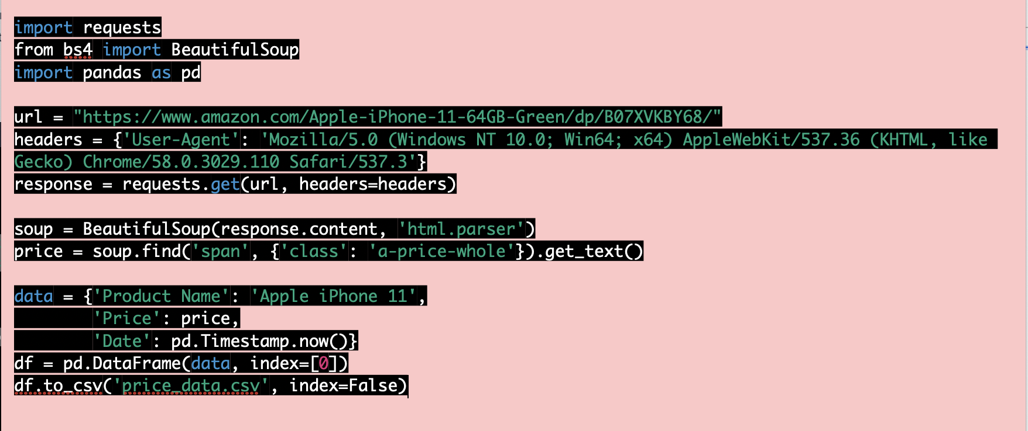
In this example, we are extracting the price of an iPhone 11 from Amazon and saving it in a CSV file. We are using requests library to send a request to the Amazon website and then using Beautiful Soup library to parse the HTML content and extract the price data. Finally, we are saving the data in a CSV file using pandas library.
In this example, we are extracting the price of an iPhone 11 from Amazon and saving it in a CSV file. We are using requests library to send a request to the Amazon website and then using Beautiful Soup library to parse the HTML content and extract the price data. Finally, we are saving the data in a CSV file using pandas library.

Slide 56
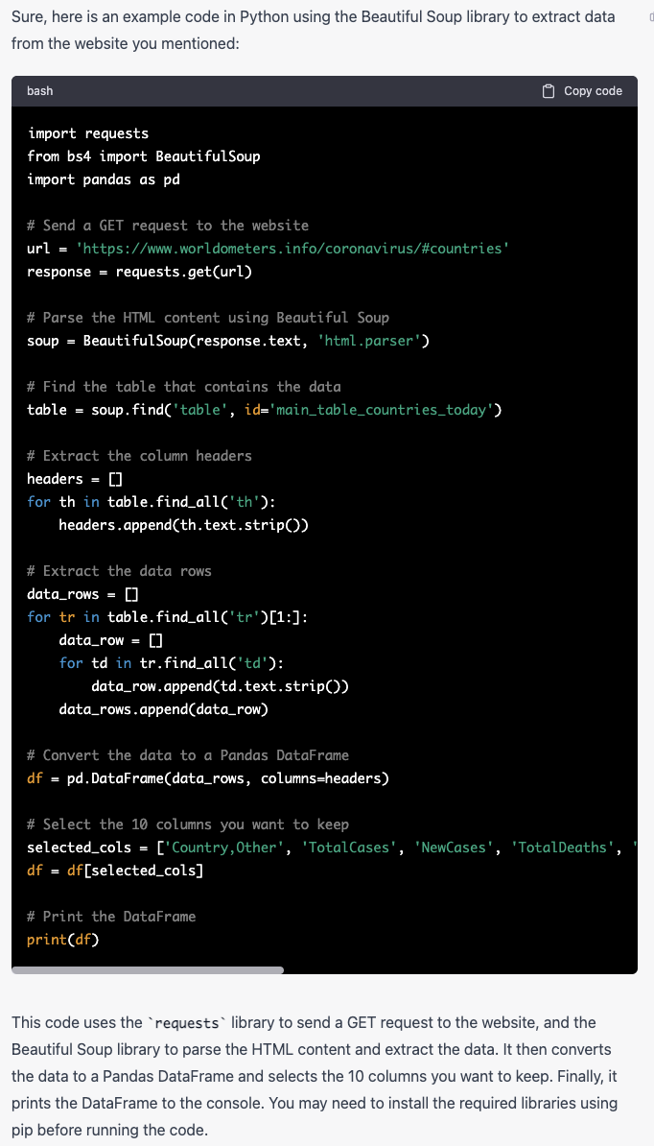
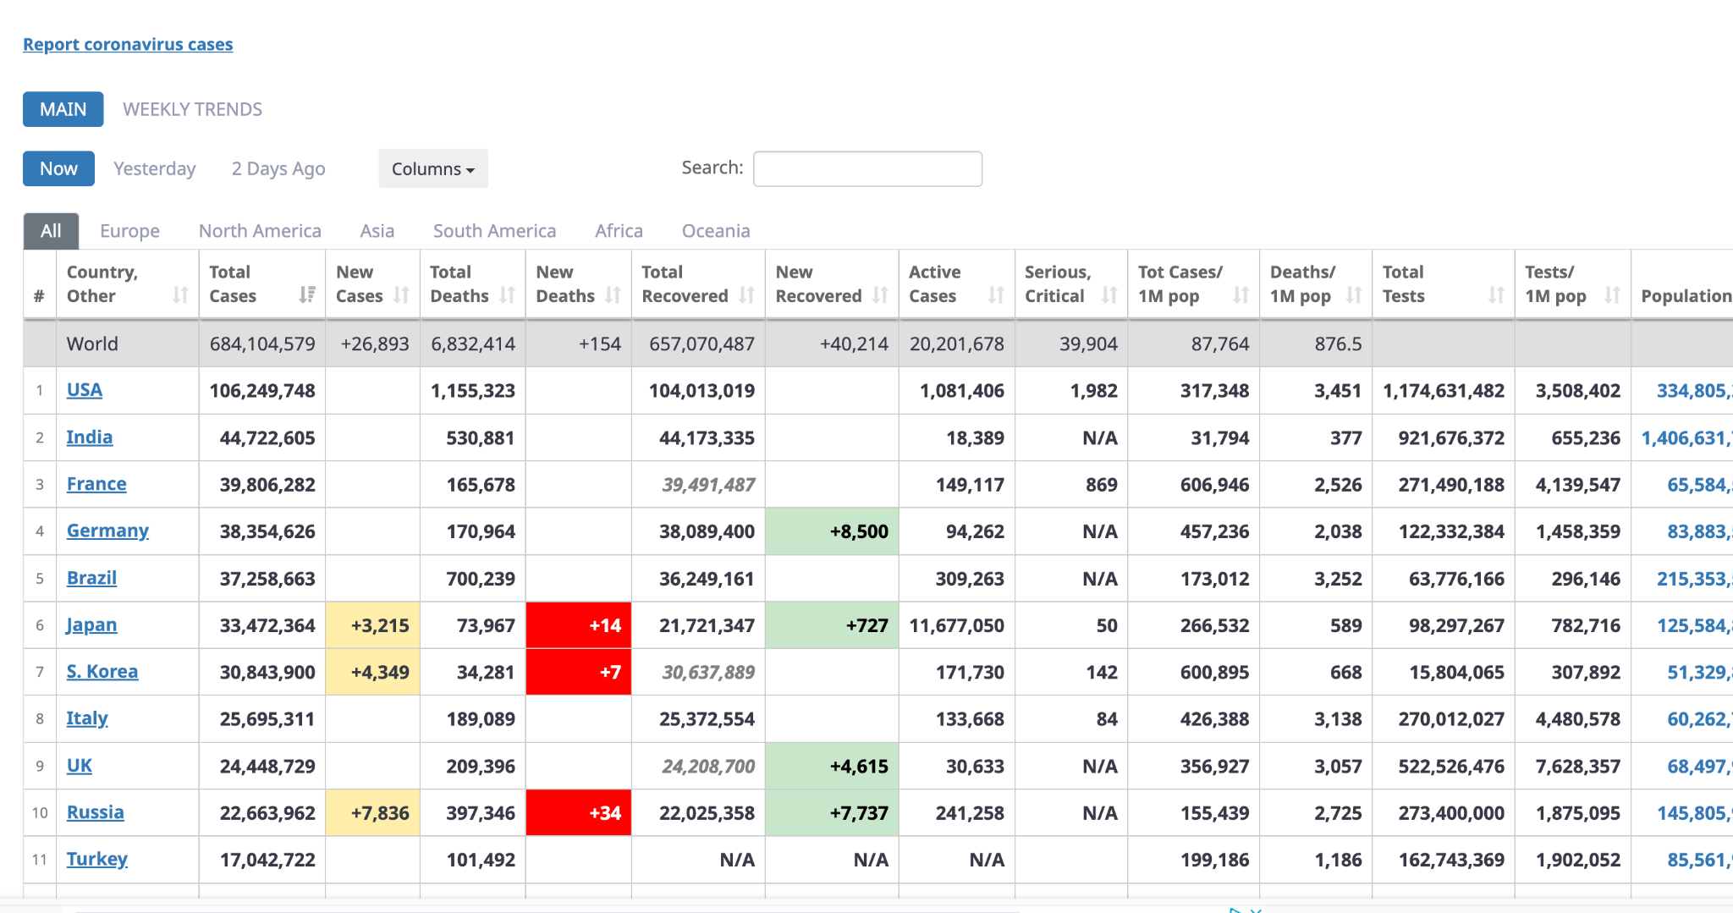
Structured Data Extraction
Say if we want to get information about the covid 19 cases.
https://www.worldometers.info/coronavirus/#countries'

Slide 57
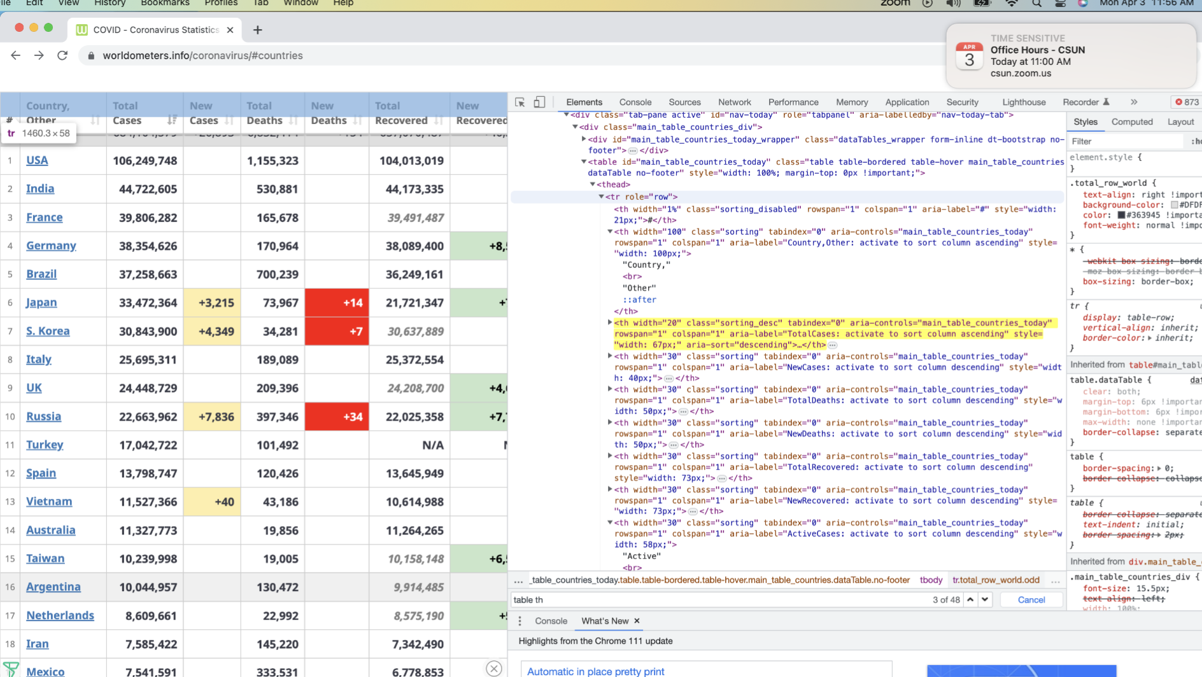

Slide 58
Information Retrieval
Information retrieval (IR) is the process of retrieving information relevant to a user's information need from a large collection of information, such as a database or the internet. IR can be applied to various types of information, such as text documents, images, audio, and video.
Web search is a specific type of IR that focuses on retrieving information from the World Wide Web, which is a vast collection of web pages and other online resources connected by hyperlinks. Web search engines use a combination of techniques to retrieve and rank web pages based on their relevance to a user's search query.
Some common techniques used in IR and web search include:
Indexing: This involves creating an index of the information in a collection, which allows for faster searching and retrieval.
Query processing: This involves processing a user's search query to identify relevant information in the collection.
Ranking: This involves ordering the results of a search query based on their relevance to the user's information need.
Retrieval models: These are mathematical models that help determine the relevance of a document to a query.
Natural language processing: This involves using techniques such as parsing and semantic analysis to understand the meaning of a user's search query and to identify relevant information in a collection.
Machine learning: This involves using algorithms to automatically learn patterns and relationships in data, which can be used to improve the effectiveness of IR and web search.
Overall, IR and web search play a critical role in helping users find the information they need quickly and efficiently, and they continue to be an active area of research and development.

Slide 59
Web Search
Web search is the process of using a search engine to find information on the internet. When you enter a keyword or phrase into a search engine, such as Google, Bing, or Yahoo, the search engine returns a list of results that match your query. The search engine uses complex algorithms to scan millions of web pages and rank them based on relevance and other factors. Web search is an essential tool for finding information on virtually any topic and is widely used for research, entertainment, and many other purposes.
At a high level, the process of web search using machine learning typically involves the following steps:
Data collection: Web search engines collect vast amounts of data from websites, social media, and other online sources. This data includes text, images, videos, and other forms of content.
Data preprocessing: The collected data is then preprocessed to extract relevant features and reduce noise. This step may include text cleaning, stemming, and stop-word removal.
Machine learning models: Machine learning models are then trained using the preprocessed data. Common models include decision trees, random forests, neural networks, and support vector machines.
Ranking algorithms: Once the models are trained, ranking algorithms are used to determine the relevance and importance of search results. These algorithms take into account factors such as keyword relevance, user intent, and popularity of web pages.
User feedback: Finally, user feedback is used to improve the search engine's performance. This feedback may include click-through rates, bounce rates, and user satisfaction ratings.
Overall, machine learning plays a critical role in web search by enabling search engines to provide fast, accurate, and relevant results to users.

Slide 60
Web Search
In terms of data mining, web search involves using techniques and tools to extract useful information from large amounts of unstructured data on the web.
The process of web search using data mining typically involves the following steps:
Data collection: Web search engines collect vast amounts of data from websites, social media, and other online sources. This data includes text, images, videos, and other forms of content.
Data preprocessing: The collected data is then preprocessed to extract relevant features and reduce noise. This step may include text cleaning, stemming, and stop-word removal.
Data mining techniques: Data mining techniques are then applied to the preprocessed data. These techniques may include clustering, classification, association rule mining, and anomaly detection.
Information extraction: Once patterns and trends are identified using data mining techniques, information extraction algorithms are used to extract specific pieces of information from the data. This may include identifying entities, relationships, and sentiment.
Visualization: Finally, the extracted information is presented to users in a useful and understandable way. This may involve creating charts, graphs, and other visualizations.
Overall, data mining plays a critical role in web search by enabling search engines to extract useful information from the vast amount of unstructured data available on the web. By using data mining techniques, search engines can provide users with more relevant and useful search results, improving the user experience and helping to drive the growth of the web.

Slide 61
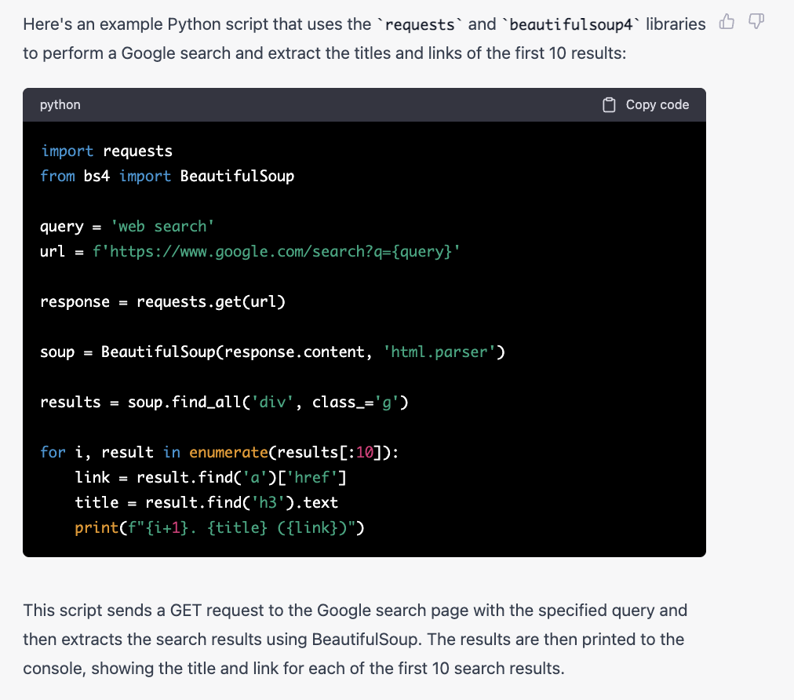

Slide 62
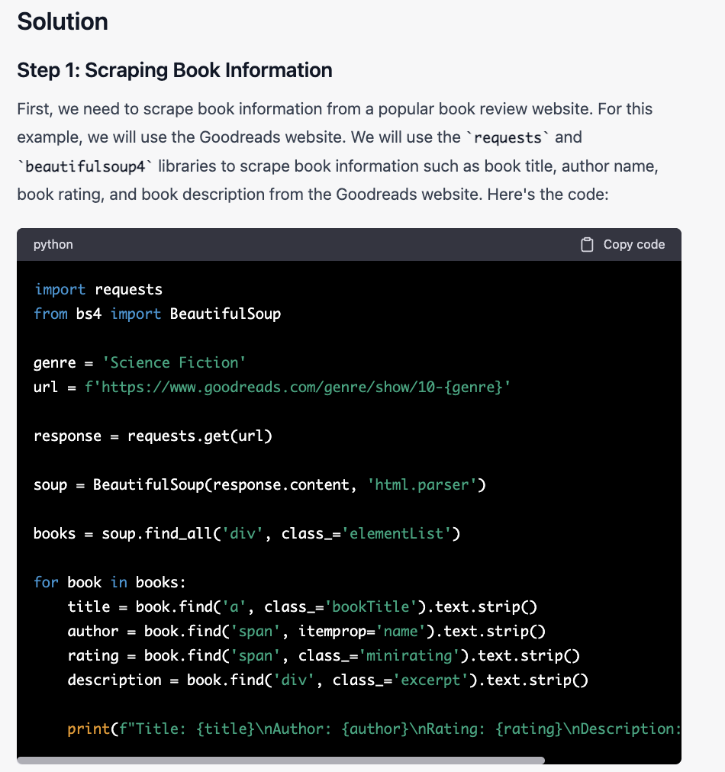
Problem Statement
As a book enthusiast, you want to gather information on the most popular books in a specific genre. You plan to use web scraping techniques to extract information on books from a popular book review website and use web search techniques to obtain additional information on the books such as author details, publisher details, and reviews.

Slide 63
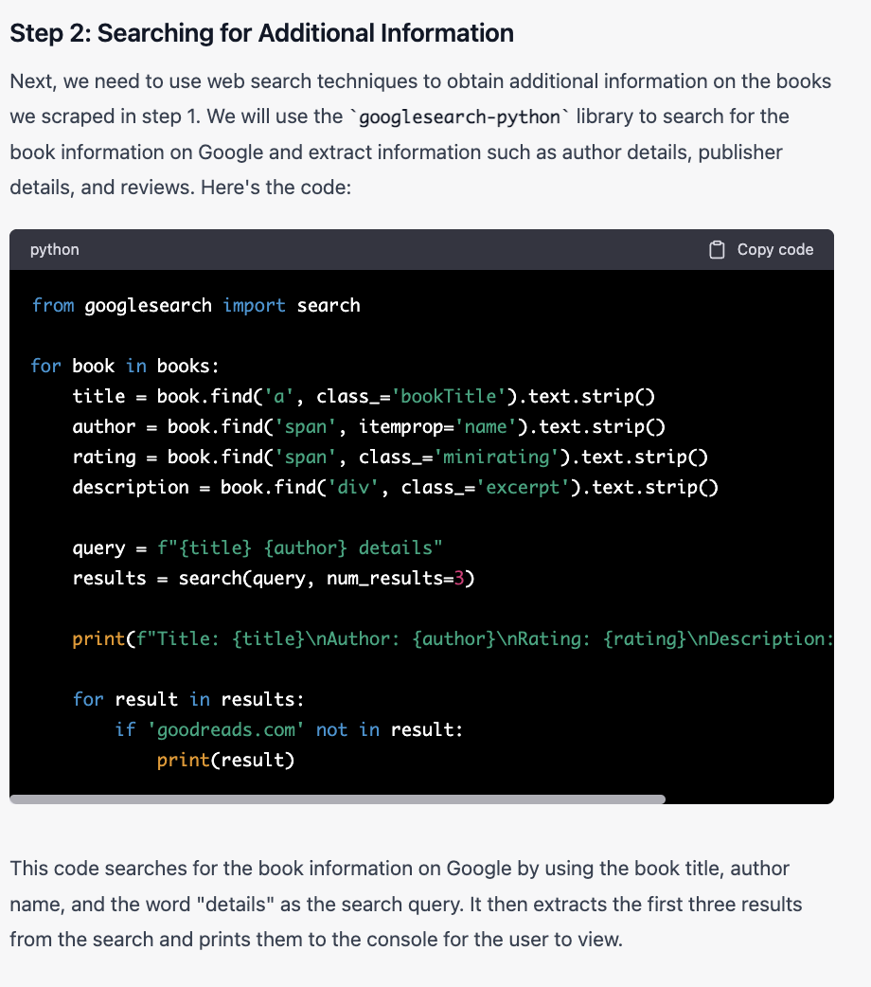

Slide 64
In this case study, we used web scraping and web search techniques to gather information on popular books in a specific genre. We first scraped book information from a popular book review website using BeautifulSoup and then used the googlesearch-python library to search for additional information on the books. This approach can be extended to gather information on other topics by scraping information from relevant websites and using web search techniques to obtain additional information.

Slide 65
Search Engines
Search engines can be categorized into different types including crawlers, directories, hybrids, and meta search engines. Crawlers use spiders or crawlers to search the internet for keywords and store the pages in the search engine's database. Examples include Google and Yahoo. Directories are human-powered search engines that require approval by editorial staff. The Internet Public Library and the Open Directory Project are examples of directories. Hybrids are a mix of crawlers and directories, while meta search engines search multiple search engines at once and combine the results. Although meta search engines provide more results, the relevancy and quality of the results may suffer.

Slide 66
Metasearch
In simple terms, a metasearch engine takes the query you've entered and gathers results from multiple search engines online, such as Google, Bing, Yahoo, and more. They aggregate the results for you so you can choose the best information from the search results provided.
Some service-based industries such as airlines and hotel chains use a form of the metasearch engine. If you are searching for a hotel room in a city, you will likely find websites that will scour hotels in that city. The search engine will then return different results from searching specific hotel websites. You can sometimes even see the same hotel room for different prices at other websites due to your metasearch.

Slide 67
What Is the Difference between a Search Engine and a Metasearch Engine?
A search engine sends out queries to websites to see if the website’s content best matches the search query entered into the search engine. It returns with a results page, ranked from most relevant, according to algorithms.
A metasearch engine submits queries to multiple search engines and aggregates the results into a list. The search engine can sort this list they came from, by subject, or by relevance. The user can then choose which results best match their intent.

Slide 68
How do meta search engines work?
If the user enters a search term or phrase in the search slot of a metasearch engine and starts the search function, the machine will send the request to many other search engines. Before the metasearch engine can show any results, their servers have to wait for the answers from each requested search engine. In some metasearch engines, the results list continues to get updated as results from other search engines come in.
Depending on how they are adjusted, the metasearch follows certain guidelines in the presentation of results. For example, the results may be compiled based on the popularity of the requested search engines. A pre-evaluated listing of search results is possible as well. A metasearch engine also filters out duplicates so that a URL does not appear twice in the search result list for a search query.
With many metasearch engines, such as MetaGer, you can even select the search engines to be used for the meta search and can therefore influence the search results, or tailor them to your needs.

Slide 69
Building a metasearch engine can be a complex process, but here are some general steps you can follow to create one:
Determine the purpose and scope of your metasearch engine: Before you start building your metasearch engine, you need to determine what it will be used for and what types of information it will search for. This will help you decide which search engines and databases you will need to access and what kind of features you want to include.
Gather data from different search engines: In order to create a metasearch engine, you need to gather data from multiple search engines and databases. This can be done by using web crawlers or API services provided by the search engines. You will need to collect search results, including URLs and metadata, from each of the search engines you choose to use.
Normalize the data: The data you collect from different search engines will likely be in different formats, so you will need to normalize it to a common format. This involves standardizing the way data is stored and presented so that it can be easily compared and combined.
Develop a ranking algorithm: Once you have collected and normalized the data, you need to develop a ranking algorithm that will determine the order in which search results are displayed. This algorithm should take into account factors such as relevance, popularity, and authority.

Slide 70
Build the user interface: The user interface is the part of the metasearch engine that users interact with. It should be easy to use and provide relevant search results. You can build the user interface using a web development framework or a content management system.
Test and refine: Once you have built the metasearch engine, you need to test it thoroughly and refine it based on user feedback. This will help you improve the accuracy of search results and make the user experience more satisfying.
Launch and promote: Finally, you can launch your metasearch engine and promote it through advertising, social media, and other marketing channels. You may also need to maintain and update the search engine regularly to ensure that it continues to provide accurate and relevant results.

Slide 71
Here are some steps you can follow to build a simple metasearch engine in Python:
Choose the search engines: First, you need to choose the search engines that you want to use. You can use Google, Bing, Yahoo, or any other search engine that provides an API. You will need to obtain an API key from each search engine to access their search results.
Install the necessary libraries: To access the search engine APIs and process the search results, you will need to install the necessary Python libraries. These may include requests, BeautifulSoup, and json.
Create a function to retrieve search results: Next, you need to create a Python function that retrieves search results from the selected search engines. You will need to pass the search query and API key as parameters to this function.
Parse the search results: Once you have retrieved the search results from the search engines, you need to parse them to extract the relevant information. This may include the URLs, titles, descriptions, and other metadata.
Normalize the data: You will likely need to normalize the data you have collected from different search engines. This may involve converting the data to a common format, removing duplicates, and filtering out irrelevant results.
Rank the search results: To determine the order in which search results are displayed, you need to develop a ranking algorithm. This algorithm should take into account factors such as relevance, popularity, and authority.
Build the user interface: Finally, you can build the user interface for your metasearch engine. This may involve creating a web page or application that allows users to enter their search queries and displays the search results.

Slide 72
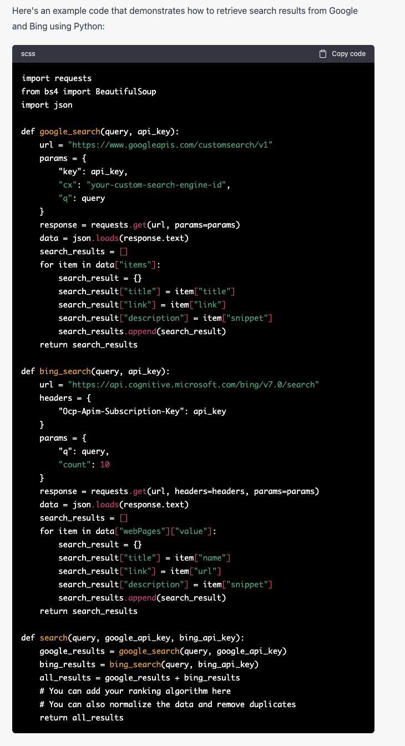
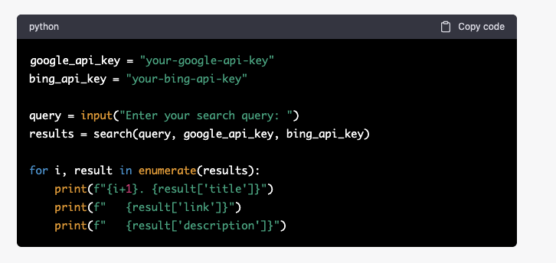

Slide 73
The code on the previous slide defines two functions, google_search and bing_search, which retrieve search results from Google and Bing, respectively. The search function combines the results from both search engines and returns them. You can modify this code to integrate the ranking algorithm and user interface. This code prompts the user to enter a search query, calls the search function with the query and API keys, and displays the search results with their title, link, and description.
Of course, this is just a simple example, and there are many ways to improve and customize the metasearch engine, such as adding more search engines, using more advanced ranking algorithms, and creating a more sophisticated user interface.

Slide 74
Web Spamming
Web spamming refers to the practice of using unethical and manipulative techniques to achieve higher search engine rankings for a website. This can include using various tactics such as keyword stuffing, link spamming, cloaking, and hidden text, among others. The ultimate goal of web spamming is to deceive search engines and users, thereby increasing the visibility of a website and driving more traffic to it.
Web spamming is considered a violation of search engine guidelines and can result in penalties, including the removal of the website from search engine results pages (SERPs). This can have a significant impact on a website's online visibility and ultimately its business success.
To avoid being penalized for web spamming, it is essential to follow ethical and best practices for search engine optimization (SEO) and focus on creating high-quality content that is relevant to users' search queries. It is also important to stay up to date with search engine algorithms and guidelines to ensure compliance with the latest standards.

Slide 75
Web Spamming
Web spamming refers to the use of unethical and manipulative tactics to increase a website's search engine rankings, traffic, and visibility. It involves violating search engine guidelines and manipulating search engine algorithms to deceive search engines and users.
Web spamming differs from legitimate search engine optimization (SEO) practices in that it uses tactics that violate search engine guidelines and attempt to manipulate the search results. In contrast, legitimate SEO practices involve optimizing a website's content and structure to make it more user-friendly and easily discoverable by search engines.
Some common tactics used in web spamming include keyword stuffing, which involves overusing keywords in an attempt to manipulate search engine rankings, and link spamming, which involves creating numerous low-quality backlinks to a website to increase its authority. Other tactics include cloaking, which involves showing different content to search engines and users, and hidden text, which involves hiding text on a website to manipulate search engine rankings.
Therefore, it's important to avoid using these tactics and instead focus on ethical and best practices for SEO. This includes creating high-quality content, optimizing website structure and navigation, and building quality backlinks from reputable sources. By following these practices, websites can achieve higher rankings and visibility in search results without resorting to web spamming.

Slide 76
Web spamming is the practice of using manipulative techniques to deceive search engines and website visitors, often for the purpose of generating traffic or revenue. It is considered a black hat SEO technique that violates search engine guidelines and can result in penalties, loss of reputation, and damage to user experience.
There are several reasons why web spamming is bad:
Deceptive: Web spamming relies on misleading tactics to artificially inflate website rankings and deceive users. This can include hidden text, cloaking, keyword stuffing, and link schemes.
Unethical: Web spamming violates search engine guidelines and is considered an unethical practice that undermines the integrity of the web. It can also harm legitimate websites that follow the rules and provide high-quality content.
User experience: Web spamming can result in a poor user experience by directing users to irrelevant or low-quality content. This can lead to frustration, distrust, and loss of engagement.
Penalties: Search engines penalize web spamming by lowering website rankings, removing pages from the index, or even banning websites altogether. This can have serious consequences for website traffic and revenue.

Slide 77
Suppose you run a website that sells organic skincare products. Here are some steps you can take to optimize your website for search engines without resorting to web spamming:
Conduct keyword research: Research the keywords that your target audience uses when searching for organic skincare products. Use tools such as Google Keyword Planner to identify relevant keywords and phrases.
Create high-quality content: Write informative and engaging content that addresses your audience's needs and interests. Use the keywords you identified in step 1 to optimize your content for search engines. Avoid stuffing your content with too many keywords, which can be seen as a web spamming tactic.
Optimize website structure and navigation: Ensure that your website has a clear and organized structure that makes it easy for search engines and visitors to navigate. Use descriptive URLs, headers, and meta descriptions to help search engines understand the content of your pages.
Build quality backlinks: Reach out to reputable websites in your industry and request backlinks to your website. Create valuable content such as blog posts, infographics, and videos that other websites would want to link to. Avoid using paid links, link farms, or other manipulative tactics that can be seen as web spamming.
By implementing these ethical and best practices, your website can achieve higher rankings and visibility in search results for relevant keywords. You'll also build trust and credibility with search engines and visitors, which can lead to increased traffic, engagement, and sales.

Slide 78
Web spamming is a set of manipulative tactics used to deceive search engines and artificially boost a website's rankings in search results.
Web spamming violates search engine guidelines and can result in penalties, loss of reputation, and damage to user experience.
Web spamming tactics include keyword stuffing, cloaking, link schemes, hidden text, and other forms of black hat SEO.
Web spamming can be detrimental to your website's long-term success and sustainability online. Instead, it's important to focus on ethical and best practices for SEO, such as creating high-quality content, optimizing website structure and navigation, and building quality backlinks from reputable sources.
By following these practices, websites can achieve higher rankings and visibility in search results without resorting to web spamming. This can lead to increased traffic, engagement, and conversions, as well as build trust and credibility with search engines and visitors.

Slide 79
Why Do We Care About Anomalies?
Detecting outliers or anomalies is one of the core problems in data mining. The emerging expansion and continued growth of data and the spread of IoT devices, make us rethink the way we approach anomalies and the use cases that can be built by looking at those anomalies.

Slide 80
Anomaly Detection
Anomaly detection refers to the problem of finding patterns in data that do not conform to expected behaviour. The importance of anomaly detection is due to the fact that anomalies in data translate to significant (and often critical) actionable information in a wide variety of application domains.
In popular parlance, Anomaly detection finds extensive use in a wide variety of applications such as fraud detection for credit cards, insurance or health care, intrusion detection for cyber-security, fault detection in safety critical systems, and military surveillance for enemy activities.

Slide 81
Example of when to apply Anomaly detection:
Case Study: Anomaly Detection in Network Traffic
A company wants to detect anomalies in their network traffic to identify potential security threats. They decide to use an unsupervised anomaly detection algorithm to identify any unusual patterns in the network traffic.
The company collects network traffic data for a period of time and then applies an unsupervised anomaly detection algorithm to the data. The algorithm uses statistical methods to identify patterns in the data and flags any data points that fall outside of the expected range as anomalies.
After running the algorithm, the company discovers several anomalies in the network traffic. Upon further investigation, they find that some of the anomalies are due to legitimate traffic patterns, while others are indicative of potential security threats. The company takes action to address the security threats and fine-tunes the anomaly detection algorithm to improve its accuracy.
Overall, the application of anomaly detection to network traffic data helped the company identify potential security threats and take proactive measures to address them. By detecting anomalies in real-time, the company was able to prevent potential security breaches and protect their network from malicious activity.

Slide 82
Methodologies
Statistical Methods: Statistical methods are often used in anomaly detection and involve defining a statistical model to identify data points that fall outside of the expected range. Common statistical methods include Z-score, Percentiles, and Mahalanobis distance.
Machine Learning Methods: Machine learning methods are often used in anomaly detection, and can be both supervised and unsupervised. Supervised machine learning methods involve training a model on labeled data, while unsupervised machine learning methods do not require labeled data. Common machine learning methods include K-means clustering, Support Vector Machines (SVMs), and Isolation Forests.
Time Series Analysis: Time series analysis is a methodology that is used for detecting anomalies in sequential data. It involves analyzing the patterns in the time series data and detecting any deviations from the expected patterns. Common time series analysis methods include Autoregressive Integrated Moving Average (ARIMA), Exponential Smoothing, and Seasonal Decomposition.
Deep Learning Methods: Deep learning methods involve using deep neural networks to detect anomalies. Deep learning methods can be both supervised and unsupervised and can be used to detect anomalies in both structured and unstructured data. Common deep learning methods include Autoencoders, Recurrent Neural Networks (RNNs), and Convolutional Neural Networks (CNNs).
Rule-Based Methods: Rule-based methods involve defining a set of rules to identify anomalies. These rules can be based on domain expertise, heuristics, or other factors. Common rule-based methods include Expert Systems, Decision Trees, and Bayesian Networks.

Slide 83
Anomaly Detection Techniques
Anomaly detection is a technique used to identify data points in dataset that does not fit well with the rest of the data. It has many applications in business such as fraud detection, intrusion detection, system health monitoring, surveillance, and predictive maintenance. Anomalies, which are also called outlier, can be divided into following three categories −
Point anomalies − It occurs when an individual data instance is considered as anomalous w.r.t the rest of the data.
Contextual anomalies − Such kind of anomaly is context specific. It occurs if a data instance is anomalous in a specific context.
Collective anomalies − It occurs when a collection of related data instances is anomalous w.r.t entire dataset rather than individual values.

Slide 84
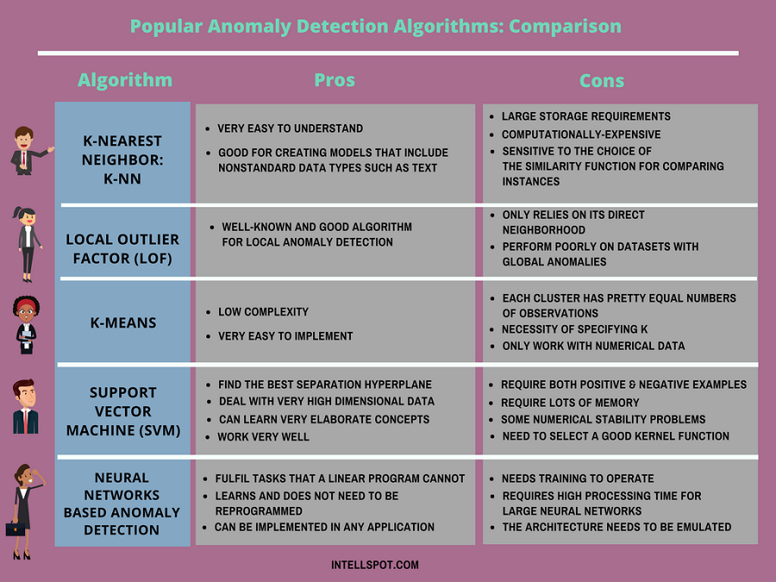

Slide 85
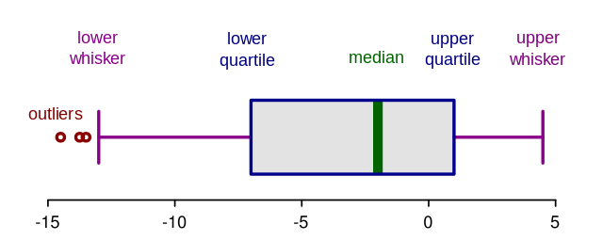
Boxplots
Box plots are a graphical depiction of numerical data through their quantiles. It is a very simple but effective way to visualize outliers. Think about the lower and upper whiskers as the boundaries of the data distribution. Any data points that show above or below the whiskers, can be considered outliers or anomalous. Here is the code to plot a box plot:

Slide 86
Boxplot anatomy
The concept of the Interquartile Range (IQR) is used to build the boxplot graphs. IQR is a concept in statistics that is used to measure the statistical dispersion and data variability by dividing the dataset into quartiles.
In simple words, any dataset or any set of observations is divided into four defined intervals based upon the values of the data and how they compare to the entire dataset. A quartile is what divides the data into three points and four intervals.

Slide 87
Support Vector Machine and Anomaly detection
SVMs can be used for anomaly detection by creating a hyperplane that separates normal data from anomalous data.
Data preparation is the first step and involves collecting and preparing a balanced dataset with both normal and anomalous data points.
Feature extraction is the process of identifying relevant features from the dataset that can be used for classification.
The SVM model is trained using the normal data points and involves selecting the appropriate kernel function, setting the regularization parameter, and defining the hyperplane.
The performance of the SVM model is evaluated by testing it on a separate set of data points that include both normal and anomalous data.
A threshold value is selected to separate normal and anomalous data points based on the distribution of scores generated by the SVM model.
Anomaly detection involves using the trained SVM model and the selected threshold to detect anomalies in new data points.
SVMs are popular for anomaly detection because they can create an optimal boundary that maximizes the margin between normal and anomalous data.

Slide 88
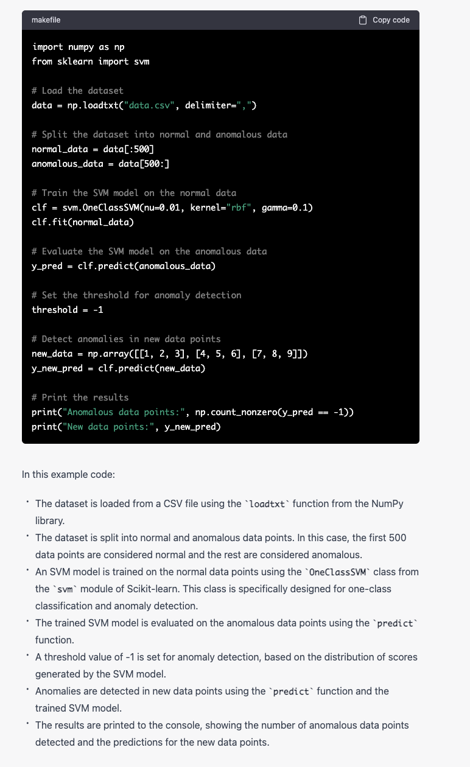

Slide 89
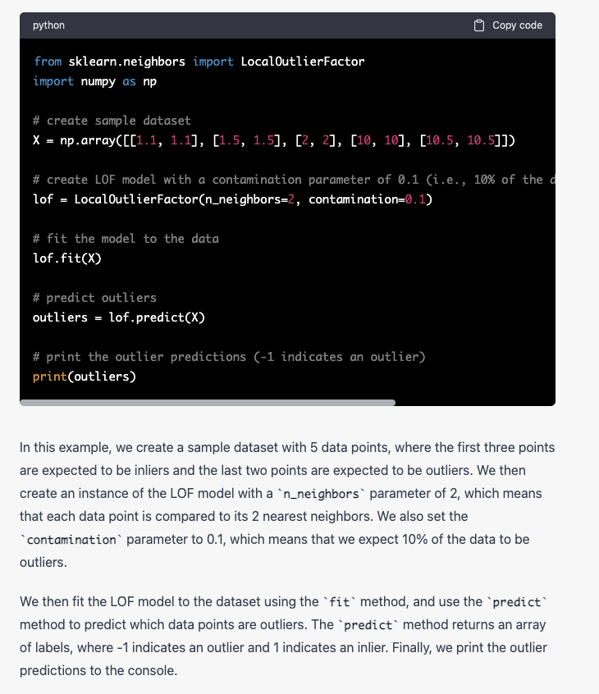
Local Outlier Factor (LOF): LOF is a density-based outlier detection method that measures the local density of a data point relative to its neighbors. A data point with a significantly lower local density than its neighbors is considered an outlier.

Slide 90
Simplified Example (LOF)
Imagine you have a group of friends who like to hang out together. You're all going to a party and you're trying to figure out who's going to be the outlier - the person who doesn't really fit in with the group.
To figure this out, you might look at each person and compare them to their closest friends. If someone is significantly farther away from their closest friends than the other people are from theirs, they might be the outlier.
For example, if you have a group of friends who are all about the same age, but one person is much older or younger, they might be the outlier. Or if everyone in the group is a fan of a certain band, but one person hates their music, they might be the outlier.
In LOF outlier detection, we do something similar with data points in a dataset. We look at each data point and compare it to its closest neighbors. If a data point is significantly farther away from its neighbors than the other data points are from theirs, it might be an outlier.
For example, if you have a dataset of housing prices, but one house is significantly more expensive or less expensive than the houses in its neighborhood, it might be an outlier. Or if you have a dataset of customer behavior, but one customer's behavior is significantly different from the behavior of other customers who are similar to them, they might be an outlier.

Slide 91
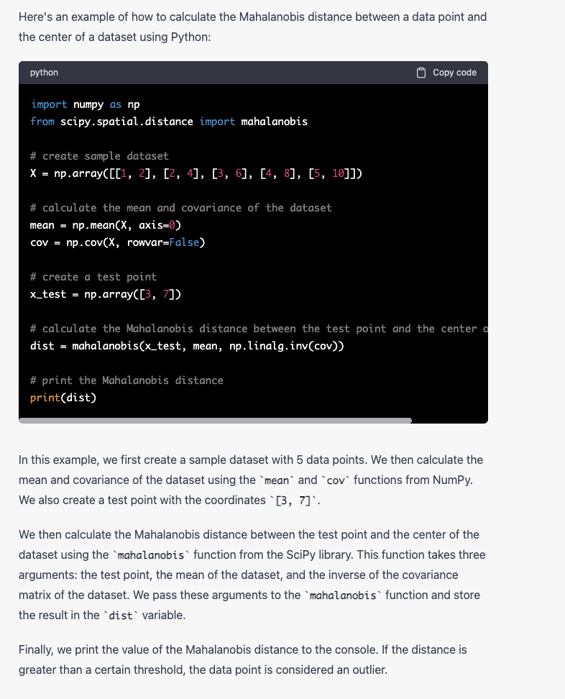
Mahalanobis Distance: Mahalanobis distance is a statistical method that measures the distance between a data point and the center of a dataset, taking into account the covariance of the variables. Data points with a Mahalanobis distance greater than a certain threshold are considered outliers.

Slide 92
Simplified Example
Imagine you're trying to decide which restaurant to go to for dinner. You have two options: a fancy French restaurant or a casual pizza place. You want to choose the restaurant that's closest to your tastes.
To make this decision, you might consider three factors: the quality of the food, the price, and the atmosphere. You have a certain preference for each of these factors, and you want to choose the restaurant that's closest to your preferences.
Now imagine that you have a friend who has already visited both restaurants and has rated them on these three factors. Your friend's ratings might be represented as a vector with three values: one for the quality of the food, one for the price, and one for the atmosphere.
To compare your preferences to your friend's ratings, you could use the Mahalanobis Distance. The Mahalanobis Distance takes into account the covariance between the three factors, which means that it can give more weight to factors that are highly correlated and less weight to factors that are not.
For example, if your friend rated the French restaurant very highly on food quality and atmosphere, but only moderately on price, the Mahalanobis Distance would give more weight to the food quality and atmosphere ratings and less weight to the price rating, because those two factors are highly correlated in this case.
Using the Mahalanobis Distance, you could calculate the distance between your preferences and your friend's ratings, and choose the restaurant that has the shortest distance. This would give you a more accurate measure of how close each restaurant is to your preferences, taking into account the covariance between the different factors.

Slide 93
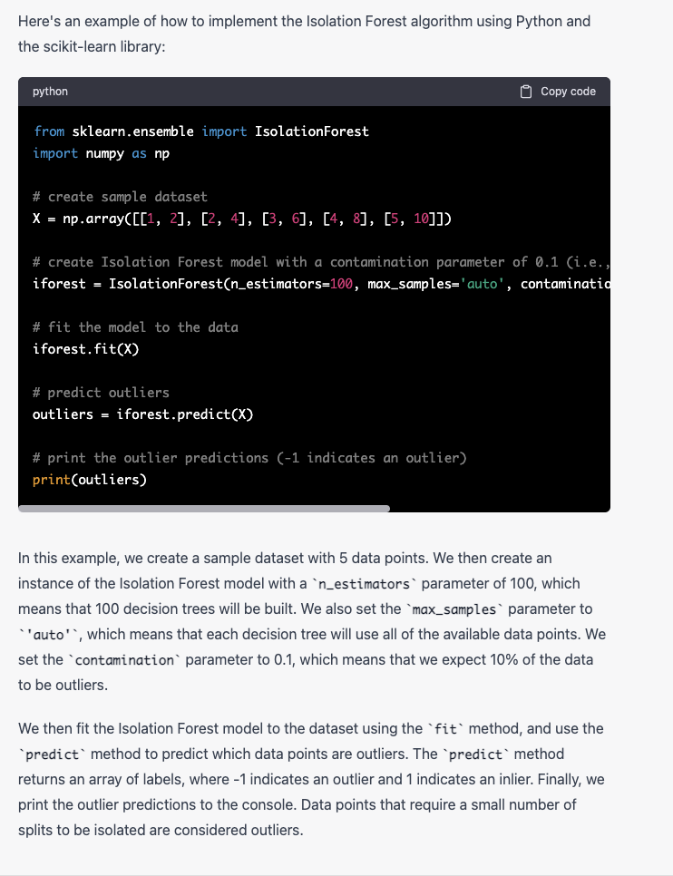
Isolation Forest: Isolation Forest is a tree-based outlier detection method that randomly isolates data points in a tree structure. Data points that require a small number of splits to be isolated are considered outliers.

Slide 94
Simplified Example
Imagine you have a group of animals, such as lions, tigers, bears, and monkeys. You want to find out which animal is the least common, or the "outlier".
To do this, you take each animal and put it in its own tree. Then, you start at the top of the tree and randomly choose another animal to compare it to. If the new animal is the same as the one at the top of the tree, you move down to the next level and repeat the process. If the new animal is different, you split the tree into two branches: one branch for the animal at the top of the tree and another branch for the new animal. You then repeat the process with another randomly chosen animal, splitting the tree further as necessary.
The idea behind the Isolation Forest algorithm is that the animal that requires the fewest number of splits to be isolated is the least common, or the "outlier". For example, if you find that the monkey requires only one split to be isolated, while the other animals require multiple splits, the monkey is considered the outlier.
In a real-world scenario, the Isolation Forest algorithm could be used to identify outliers in a dataset, such as defective products in a manufacturing dataset or abnormal traffic patterns in a network dataset. By randomly isolating data points in a tree structure, the algorithm can efficiently identify potential outliers that require fewer splits to be isolated than the majority of the data points.

Slide 95
How can we apply this?
Boston Housing dataset to demonstrate how outlier detection and data mining techniques can be applied to a real-world dataset. The Boston Housing dataset contains information about various attributes of houses in Boston, such as the number of rooms, crime rate, and distance to employment centers. The goal of this dataset is to predict the median value of owner-occupied homes in thousands of dollars.

Slide 96
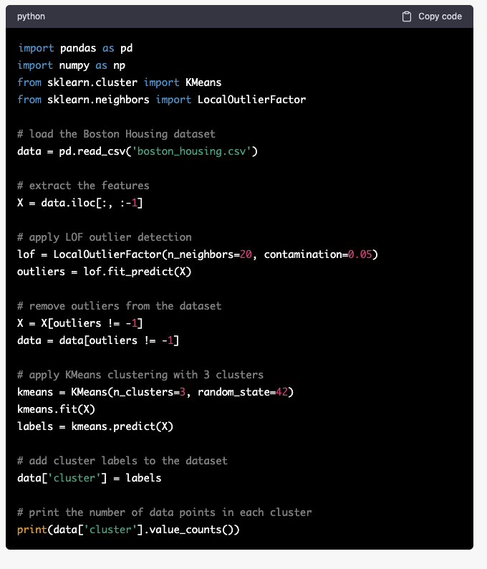
In this code, we first load the Boston Housing dataset using the read_csv function from the Pandas library. We then extract the features of the dataset, which are all the columns except for the last one.
We then apply the Local Outlier Factor (LOF) outlier detection method to the dataset. We create an instance of the LOF model with a n_neighbors parameter of 20 and a contamination parameter of 0.05, which means that we expect 5% of the data to be outliers. We then fit the LOF model to the dataset using the fit_predict method, and use the outliers variable to remove the outliers from the dataset.
We then apply the KMeans clustering algorithm to the dataset. We create an instance of the KMeans model with a n_clusters parameter of 3 and a random_state parameter of 42. We then fit the KMeans model to the dataset using the fit method, and use the predict method to predict the cluster label for each data point in the dataset. We add the cluster labels to the dataset as a new column.
Finally, we print the number of data points in each cluster using the value_counts method from Pandas. This gives us an idea of how the data points are distributed among the different clusters.
By applying outlier detection and clustering to the Boston Housing dataset, we can potentially identify patterns in the data and discover interesting insights about the housing market in Boston. For example, we may find that houses in certain areas are more likely to be outliers, or that houses with certain attributes are more likely to be grouped together in the same cluster.

Slide 97
One more use case
Anomaly detection and outlier detection can be used to improve the accuracy of prediction models by identifying and removing data points that may negatively affect the model's performance. Here's an example of how anomaly detection and outlier detection can be used in a prediction model:
Let's say you have a dataset of customer transactions and you want to build a prediction model to predict the likelihood of a customer returning to make another purchase. The dataset contains both normal transactions and anomalous transactions, which may represent fraudulent activity or data errors.
To build an accurate prediction model, you can use anomaly detection and outlier detection to identify and remove anomalous data points that may negatively affect the model's performance. Here's how you can do it:

Slide 98
Data Preparation: Collect and prepare the dataset for analysis. Ensure that you have a balanced dataset with both normal and anomalous data points.
Feature Extraction: Extract relevant features from the dataset that can be used for prediction. Feature extraction is important for improving the accuracy of the prediction model.
Anomaly Detection: Use an anomaly detection technique, such as the Isolation Forest algorithm, to identify anomalous data points in the dataset. Remove the anomalous data points from the dataset to improve the accuracy of the prediction model.
Outlier Detection: Use an outlier detection technique, such as the Z-score method or the Interquartile Range (IQR) method, to identify outliers in the dataset. Remove the outliers from the dataset to further improve the accuracy of the prediction model.
Train Prediction Model: Train the prediction model on the cleaned dataset. This involves selecting the appropriate machine learning algorithm, setting the hyperparameters, and evaluating the performance of the model using cross-validation.
Evaluate Prediction Model: Evaluate the performance of the prediction model on a separate set of data points. Measure the accuracy, precision, recall, and F1 score of the model.
Deployment: Deploy the prediction model in a production environment and monitor its performance over time. Re-evaluate the model periodically and update it as necessary.
In summary, anomaly detection and outlier detection can be used to improve the accuracy of prediction models by identifying and removing anomalous and outlier data points. By doing so, the model can better identify patterns and make more accurate predictions.

Slide 99
Difference between Anomaly Detection and Outlier Detection
Anomaly detection and outlier detection are two related but distinct tasks in the field of data mining and machine learning.
Anomaly detection refers to the process of identifying data points or patterns that deviate significantly from the norm or the expected behavior. The term "anomaly" is often used in a broad sense to refer to any unusual or unexpected behavior, whether it is malicious, accidental, or simply unusual. Anomaly detection techniques are used in a wide range of applications, including fraud detection, intrusion detection, fault detection, and health monitoring.
Outlier detection, on the other hand, refers specifically to the process of identifying data points that are significantly different from the other data points in a dataset. The term "outlier" is often used in a narrow sense to refer only to data points that are anomalous in a negative sense, meaning that they are considered to be erroneous, misleading, or irrelevant. Outlier detection techniques are often used in data cleaning and preprocessing tasks, as well as in some data analysis and visualization tasks.
In summary, while both anomaly detection and outlier detection are used to identify unusual data points, anomaly detection is concerned with identifying unexpected events or behaviors, while outlier detection is concerned with identifying errors or mistakes in the data.

Slide 100
Continuation of the Difference between Both
Outlier detection is the process of identifying data points that are significantly different from other data points in a dataset.
Anomaly detection is the process of identifying data points that are significantly different from expected patterns in a dataset.
Outliers are data points that are statistically different from the rest of the data, and may represent errors, anomalies, or rare events.
Anomalies are data points that are outside of expected patterns, and may represent unexpected events, rare occurrences, or errors in data collection or processing.
Outlier detection is primarily concerned with identifying statistical outliers, whereas anomaly detection is concerned with identifying data points that are outside of expected patterns.
Outlier detection can be used to identify data quality issues, detect fraudulent activity, or identify potential errors in data entry or collection.
Anomaly detection can be used to identify unusual activity in a system, detect equipment failures, or identify cybersecurity threats.
While outlier detection and anomaly detection are related, they have different goals and approaches.
Outlier detection uses statistical methods to identify outliers, while anomaly detection may use machine learning or other advanced techniques to identify anomalies.
Both outlier detection and anomaly detection are important for data analysis and can help identify potential issues or threats in a dataset.

Slide 101
Can the same techniques in anomaly detection can be used in outlier detection?
Anomaly Detection:
Identifies data points that deviate significantly from the majority of the data
Can be used in various fields such as finance, security, and healthcare
Techniques include statistical methods such as mean and standard deviation, clustering, classification, and machine learning algorithms
Applications include fraud detection, network intrusion detection, and medical diagnosis
Challenges include defining a threshold for what constitutes an anomaly and dealing with imbalanced datasets
Outlier Detection:
Identifies data points that are significantly different from the rest of the data
Can be used in various fields such as finance, data analysis, and engineering
Techniques include statistical methods such as box plots and quartiles, clustering, classification, and machine learning algorithms
Applications include detecting errors in data entry, identifying defective products, and monitoring sensor readings
Challenges include defining a threshold for what constitutes an outlier, dealing with skewed or noisy data, and handling high-dimensional datasets
Note that there is some overlap between these two techniques, and the specific techniques used may vary depending on the application.

Slide 102
What is a neural network
What is a neural network?
A neural network is a method in artificial intelligence that teaches computers to process data in a way that is inspired by the human brain. It is a type of machine learning process, called deep learning, that uses interconnected nodes or neurons in a layered structure that resembles the human brain. It creates an adaptive system that computers use to learn from their mistakes and improve continuously. Thus, artificial neural networks attempt to solve complicated problems, like summarizing documents or recognizing faces, with greater accuracy.

Slide 103
How do neural networks work?
The human brain is the inspiration behind neural network architecture. Human brain cells, called neurons, form a complex, highly interconnected network and send electrical signals to each other to help humans process information. Similarly, an artificial neural network is made of artificial neurons that work together to solve a problem. Artificial neurons are software modules, called nodes, and artificial neural networks are software programs or algorithms that, at their core, use computing systems to solve mathematical calculations.
Simple neural network architecture
A basic neural network has interconnected artificial neurons in three layers:
Input Layer
Information from the outside world enters the artificial neural network from the input layer. Input nodes process the data, analyze or categorize it, and pass it on to the next layer.
Hidden Layer
Hidden layers take their input from the input layer or other hidden layers. Artificial neural networks can have a large number of hidden layers. Each hidden layer analyzes the output from the previous layer, processes it further, and passes it on to the next layer.
Output Layer
The output layer gives the final result of all the data processing by the artificial neural network. It can have single or multiple nodes. For instance, if we have a binary (yes/no) classification problem, the output layer will have one output node, which will give the result as 1 or 0. However, if we have a multi-class classification problem, the output layer might consist of more than one output node.

Slide 104
The composition of a neural network
For unfamiliar readers, neural networks are a class of mathematical models that train to produce and optimize a definition for a function (or distribution) over a set of input features. The specific objective of a given neural network application can be defined by the operator using a performance measure (typically a cost function); in this way, neural networks may be used to classify, predict, or transform their inputs.

Slide 105
The use of the word neural in neural networks is the product of a long tradition of drawing from heavy-handed biological metaphors to inspire machine learning research. Hence, artificial neural networks algorithms originally drew (and frequently still draw) from biological neuronal structures
A neural network is composed of the following elements:
• A learning process: A neural network learns by adjusting parameters within the weight function of its nodes.
-A set of neurons or weights: Each contains a weight function (the activation function) that manipulates input data. The activation function may vary substantially between networks (with one well-known example being the hyperbolic tangent). The key requirement is that the weights must be adaptive, that is,, adjustable based on updates from the learning process.
Connectivity functions: They control which nodes can relay data to which other nodes. Nodes may be able to freely relay input to one another in an unrestricted or restricted fashion, or they may be more structured in layers through which input data must flow in a directed fashion.

Slide 106
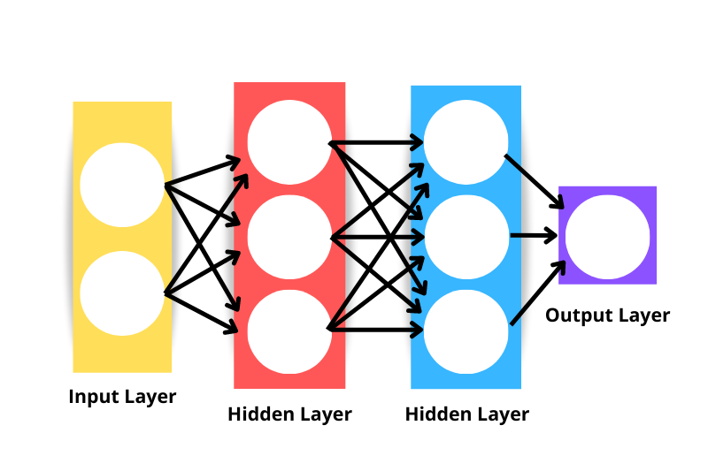
The generic neural network architecture consists of the following:
Input layer: Data is fed into the network through the input layer. The number of neurons in the input layer is equivalent to the number of features in the data. The input layer is technically not regarded as one of the layers in the network because no computation occurs at this point.
Hidden layer: The layers between the input and output layers are called hidden layers. A network can have an arbitrary number of hidden layers - the more hidden layers there are, the more complex the network.
Output layer: The output layer is used to make a prediction.
Neurons: Each layer has a collection of neurons interacting with neurons in other layers.
Activation function: Performs non-linear transformations to help the model learn complex patterns from the data.

Slide 107
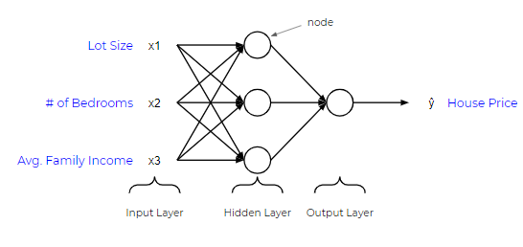

Slide 108
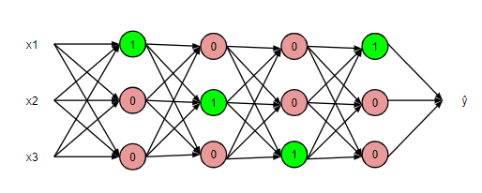
How does it even work?
What happens is that the input features (x) are fed into the linear function of each node, resulting in a value, z.
Then, the value z is fed into the activation function, which determines if the light switch turns on or not (between 0 and 1).

Slide 109
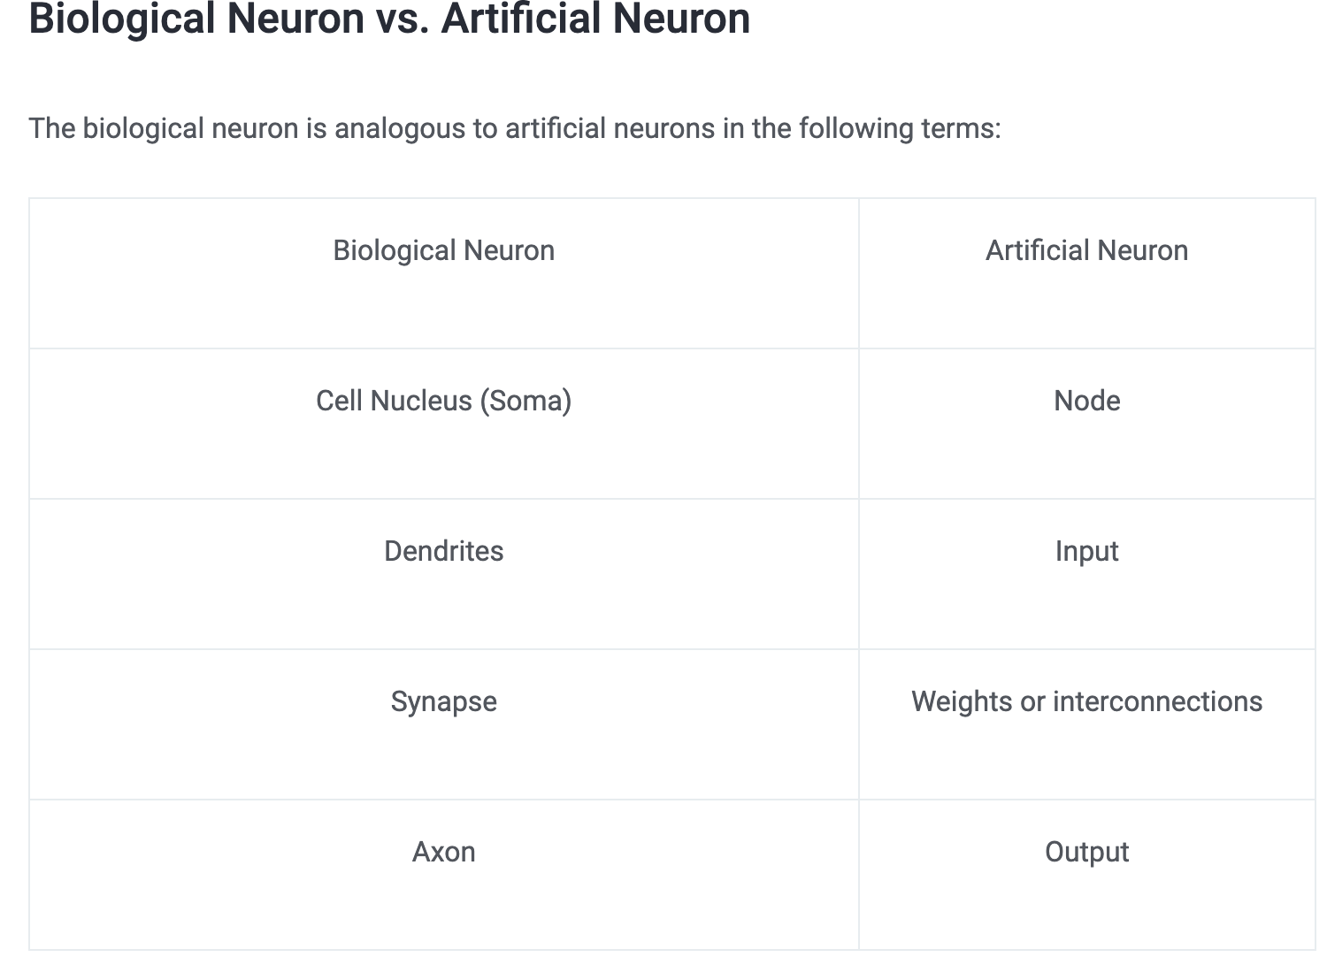

Slide 110
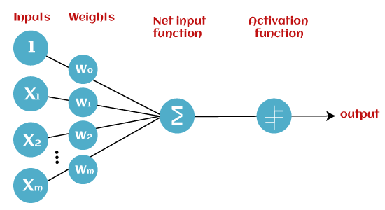
Artificial Neuron at a Glance
A neuron is a mathematical function modeled on the working of biological neurons
It is an elementary unit in an artificial neural network
One or more inputs are separately weighted
Inputs are summed and passed through a nonlinear function to produce output
Every neuron holds an internal state called activation signal
Each connection link carries information about the input signal
Every neuron is connected to another neuron via connection link

Slide 111
Basic Components of the Perceptron
Input Nodes or Input Layer:
This is the primary component of Perceptron which accepts the initial data into the system for further processing. Each input node contains a real numerical value.
Weight and Bias:
Weight parameter represents the strength of the connection between units. This is another most important parameter of Perceptron components. Weight is directly proportional to the strength of the associated input neuron in deciding the output. Further, Bias can be considered as the line of intercept in a linear equation.

Slide 112
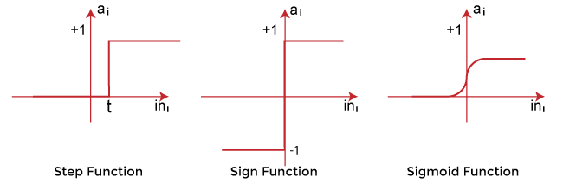
Activation Function:
These are the final and important components that help to determine whether the neuron will fire or not. Activation Function can be considered primarily as a step function.
Types of Activation functions:
Sign function
Step function, and
Sigmoid function

